Slide 1


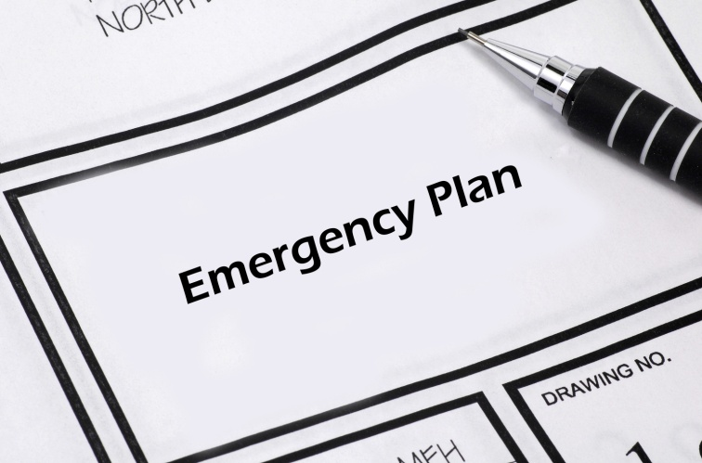
MAINTAIN THE SAFETY OF PREMISES AND PERSONNEL
D1.HSS.CL4.04
Notes:
Trainer welcomes trainees to class.

Slide 2

Maintain safety of premises and personnel
This Unit comprises six Elements:
Respond to fire and other alarms
Respond to safety threats
Respond to emergency situations
Conduct evacuations
Fulfill administrative responsibilities
Respond to a deceased person situation
Notes:
Trainer advises trainees this Unit comprises six Elements, as listed on the slide explaining:
• Each Element comprises a number of Performance Criteria which will be identified throughout the class and explained in detail
• Trainees can obtain more detail from their Trainee Manual
• At times the course presents advice and information about various protocols but where their workplace requirements differ to what is presented, the workplace practices and standards, as well as policies and procedures must be observed.

Slide 3

Assessment
Assessment for this unit may include:
Oral questions
Written questions
Work projects
Workplace observation of practical skills
Practical exercises
Formal report from employer/supervisor
Notes:
Trainer advises trainees that assessment for this Unit may take several forms, all of which are aimed at verifying they have achieved competency for the Unit as required.
Trainer indicates to trainees the methods of assessment that will be applied to them for this Unit.

Slide 4
Respond to fire and other alarms
Performance Criteria for this Element are:
Establish nature and location of alarm
Contact emergency services
Ensure access and assistance to emergency services upon their arrival
Provide first response assistance
Notes:
Trainer identifies for trainees the Performance Criteria for this Element, as listed on the slide.
Class Activity – Discussion
Trainer asks trainees questions about responding to alarms by asking questions such as:
What different types of alarms do you know of?
How might you know when an alarm has activated?
How might you contact emergency services in the event of an emergency such as a fire or injury to a patron?
What first response experience do you have in relation to emergencies?

Slide 5
Establish nature and location of alarm
It is important to establish nature and location of alarms as it is the basis for:
Knowing what is happening
Contacting emergency services
Initiating first response
Internal notifications
EMP decisions
Assessing threat/s posed
Notes:
Trainer explains importance of establishing nature and location of alarms as it provides the basis for:
Contacting and advising emergency services
Initiating first response action
Internal advice/notification to staff and guests
Decisions about which EMP to implement
Assessing threats posed by the incident.

Slide 6
Establish nature and location of alarm
Two questions must be answered when you identify an alarm has been activated:
What has triggered the alarm?
Where is the alarm indicating the emergency exists?
Notes:
Trainer states when establishing the nature and location of an alarm you must obtain precise answers to two questions:
What has triggered/activated the alarm?
This will indicate the cause/nature of the emergency:
Fire?
Motion/intruder?
Smoke?
Heat?
Water?
Gas?
Where is the alarm indicating the emergency exists?
This gives the location for action (evacuation), investigation, first response and attendance by emergency services. You need to be able to identify (as appropriate):
Department/s
Floor/s
Room/s.

Slide 7
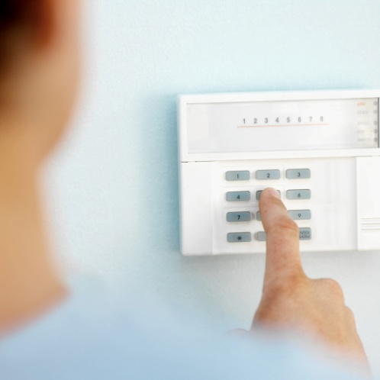
Establish nature and location of alarm
Use venue knowledge:
Be able to interpret panel indicators
Know what different audible alarms sound like and what they mean
Understand the different ‘stage levels’ of alarms (where applicable)
Notes:
Trainer explains need to use venue knowledge:
Your knowledge of internal venue alarm types should assist in determining the meaning for various audible and visual alarms
For example just by listening to an alarm you should be able to tell the difference between the fire alarm and an intruder alarm
Just by looking at a flashing light or a panel light you should be able to tell whether the alarm is a smoke alarm or a gas alert.

Slide 8
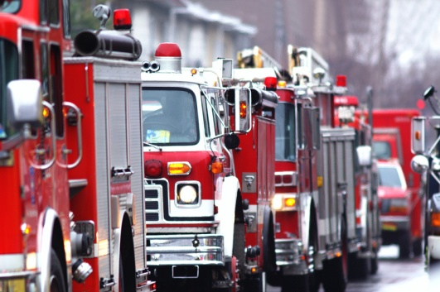
Contact emergency services
Standard practice is to contact emergency services when an alarm activates.
Emergency services are:
Fire
Police
Ambulance
Notes:
Trainer highlights it is a standard industry requirement the fire brigade must be called whenever a fire is suspected or detected and similar arrangements apply when other alarms are activated identifying the ‘emergency services’ are:
Fire
Police
Ambulance.

Slide 9
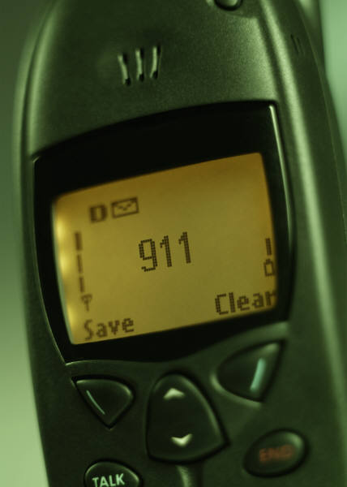
Contact emergency services
Ways to contact emergency services:
By landline or cell phone
Using direct line
Notify management
Activate an alarm
Notes:
Trainer explains fundamentals in relation to contacting emergency services will/may relate to using options available with in the venue for emergency response – these may include:
Make telephone contact (using landline phone or cell phone) with them as required by the type of alarm – for example:
Fire alarm or smoke detector alert requires contacting the fire brigade
Intruder alarm requires contacting police
Use direct lines to authorities or security companies – some venues have dedicated lines linked directly to emergency services or a central ‘command and control’ remote site operated by an external security company
Contact management – this relates to contacting your supervisor or the Duty Manager at the time.
The protocols which have been developed in the venue will then require that designated person to automatically contact emergency services as required by:
The type/nature of the emergency
The requirements of the EMP
Activate an alarm – many of these will automatically contact/alert:
A remote site – such as a control room, monitoring room or private security company
Emergency services.

Slide 10

Contact emergency services
Emergency services telephone numbers:
Know them in advance
National or local number?
Post numbers near telephones
Enter into cell phones
Enter into speed-dialing
Notes:
Trainer discusses emergency services telephone numbers stating:
It is important to know the telephone numbers for all emergency services in advance
You do not want to waste time when an emergency has occurred looking up the number
The emergency telephone numbers for all emergency services should be:
Posted in various locations throughout the venue – especially near telephones
Entered into your cell phone
Entered into speed-dialling facilities of landline telephones
Be aware your emergency services telephone numbers may be:
A national number – which can be called form any location/town/city in the country
A set of local numbers – giving you direct contact with the nearest emergency services facilities/stations.

Slide 11

Contact emergency services
When telephoning to report an emergency:
Identify yourself, position and venue location
Say you want to report an emergency
Describe the emergency
Be guided by the operator
Give location of the emergency
Notes:
Trainer states when reporting an emergency students should:
Identify yourself, position (bar attendant, Duty Manager, security staff) and venue location
State you are reporting an emergency
Describe the nature of the emergency
Be guided by the operator on the other end of the phone – as to what to do and the information to provide
Give the location of the emergency within the venue – Room number, Ballroom, cleaning cupboard on 2nd floor.
Class Activity – Guest Speaker
Trainer arranges for a representative from am emergency service to attend and:
Talk to students about how to make an emergency call
Demonstrate how to do so.

Slide 12
Contact emergency services
Identify threat
Identify numbers involved
Describe relevant local factors
Advise approach/entrance
Advise what you think is required
Do not hang up until told to do so
Notes:
Trainer continues advising how to report an emergency to emergency services using the telephone:
Identify the threat you believe is being posed
Define the numbers of people threatened/involved – people trapped; building has collapsed
Describe any local factors relevant to the emergency – power out; escaping gas; internal comms system not operational; venue very busy/crowded
Advise of best approach or entrance to use
Give your opinion regarding the action required
Never hang up until told to do so.
Class Activity – Role Play
Trainer develops various emergency scenarios and asks students to practice telephoning the relevant emergency service to report the incident and request attendance.

Slide 13
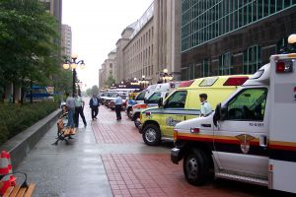
Ensure access and assistance to emergency services
Someone must be sent to meet emergency services on their arrival – this person should:
Know about the emergency and its location
Be able to provide all necessary information to assist emergency services address the emergency
Be someone with authority to give orders to staff
Notes:
Trainer explains it is standard practice in all venues to ensure, after emergency services have been called, someone is designated to meet those services on their arrival on-scene stating whoever does this job must:
Know where the emergency is and know all the details available about the emergency
Be able to quickly direct/lead the emergency workers to the emergency
Be able to provide information about the venue to the Officer-In-Charge, including information such as:
Site plans
Copy of relevant EMP
How many people are in the building
Where shut off valves and switches are
What the layout of the property is
Where potential dangers are located – such as gas tanks, petrol, flammable material
Other factors impacting on the emergency – such as the presence/location of elderly people, children/babies, disabled people, trapped guests/workers
Be someone in authority who is able to give orders/direction to staff
Anyone who has been allocated the role of awaiting the arrival of the emergency services must understand this is a very responsible position
You must not abandon this position to do something else.

Slide 14
Ensure access and assistance to emergency services
Clearing access for emergency services may include:
Moving establishment vehicles
Asking others (including taxis) to move their vehicles
Unlocking gates and barriers
Preventing others parking where emergency vehicles are expected
Clearing away tables and other items/furniture
Asking people to move away
Notes:
Trainer explains where possible the expected access route for emergency vehicles should also be cleared as far as possible stating this may include:
Moving establishment vehicles parked in front of the venue or in nearby parking areas
Requesting others to move their vehicles
Asking taxis to move
Unlocking gates and barriers
Preventing non-emergency vehicles from parking in the area you expect the emergency services vehicles to occupy
Clearing away tables, chairs, fixtures and fittings
Asking people to clear the area.
A properly prepared Emergency Management Plan will have factored these considerations into the allocated duties for staff.

Slide 15
Ensure access and assistance to emergency services
When asked by emergency services to assist:
Indicate immediately if you can or cannot
Clarify what is required
Do it
Move away when finished unless extra help is required
Do not interfere with emergency services workers – let them do their job.
Notes:
Trainer states when asked to help emergency services students should follow the following points:
Indicate immediately whether you are prepared and/or able to help – if you feel you cannot do what you have been asked to do, say so immediately
Clarify quickly (where necessary) exactly what it is you have been asked to do – so you know with certainty what is expected of you/what you are being asked to do
Do it – do not waste time thinking about it
When your assistance is no longer needed, ask if other help is required and if it is not, move out of the area – if you are not helping, you are in the way.

Slide 16
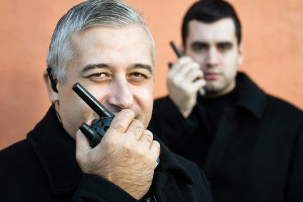
Provide first response assistance
The EMP will provide direction about what to do but sometimes you have to make on-the-spot decisions which should be based on/factor in:
Circumstances at the time
Number of people
Type of threat
Staff available
Resources available
Notes:
Trainer states all staff are expected to provide first response assistance in the event of an emergency explaining the Emergency Action/Management Plan will guide staff but in other circumstances they will have to make on-the-spot decisions about what needs to be done based on:
The circumstances which apply at the time
The number of people in danger
The type of threat
Assistance available
Resources/assets available.

Slide 17

Provide first response assistance
Remember three Golden Rules when providing first response:
Never put yourself in danger
Contact help as soon as possible
Saving lives is the priority
Notes:
Trainer reminds students if they are ever faced with an emergency situation, three Golden Rules apply:
Never put yourself in harm’s way
Always make sure emergency services are contacted as soon as possible
Always put saving lives above saving property.

Slide 18

Provide first response assistance
Generic requirements/first responses:
Follow plans
Respond immediately
Check others have been notified
Stay clam
Take action
Monitor and provide updates
Notes:
Trainer indicates the following generic requirements/responses apply for first responders:
Follow the plan for responding to the situation if one exists:
It is a workplace reality plans cannot be prepared for every possible risk, threat or emergency
If time allows, access a copy of the plan to use a guide/reference – this highlights the need for you to:
Know what the plans contain
Know where they are physically located
Respond immediately – this means:
You must do not delay
Do not procrastinate
Do not over-think the situation
Never feel you are over-re-acting
Verify others have been notified – as already identified/described including emergency services, other staff and/or management
Stay calm and composed – your action/response is vital in establishing the attitude/response of others: they will be looking to you for leadership:
Do not panic or cause panic
Do not shout – speak quietly and calmly
Do not run around
Take action to address the situation:
Use common sense
If safe to do so
As prescribed by the relevant plan
See following slides
Continue to monitor the situation – and provide up-dates to the ‘command centre’ or relevant person/warden/manager.

Slide 19
Provide first response assistance
Close doors/windows
Turn off air conditioning
Fight fires
Alert guests
Provide first aid
Move people to safety
(Continued)
Notes:
Trainer continues indicating examples of possible action to take as a first responder:
Closing doors and windows, turning of air conditioning
Fighting the fire
Knocking on doors/alerting room occupants
Providing basic first aid
Moving people/removing people form danger/the threat.

Slide 20
Provide first response assistance
Limit damage/impact
Shut off supply valves
Close/lock doors and windows as required
Open doors and windows as required
Notes:
Trainer continues indicating examples of possible action to take as a first responder:
Taking common sense action to limit damage
Shutting off supply valves and taps – for gas
Close/lock doors and windows – to stop air flow to fires and to prevent access
Open doors and windows – to help disperse gas/fumes and to enable access by emergency services (as appropriate).
Class Activity – Visit
Trainer takes students to shut off valves in the training building and:
Explains where they may be located in other buildings
Explains how to identify where they are
Explains how to close them.

Slide 21
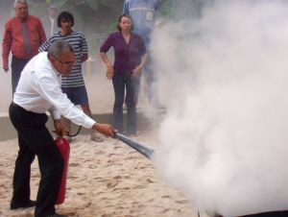
Provide first response assistance
In relation to fire-fighting equipment:
Obtain in-house training
Know the differences between extinguishers, what they are used for and how to operate them
Know locations of:
Hoses and reels
Sand buckets
Fire blankets
Notes:
Trainer continues discussing fire-fighting equipment advising students must:
Obtain in-house training before using ANY fire fighting equipment
Make sure they:
Know how to differentiate between the different types of portable fire extinguishers – CO₂, dry chemical, water: their different colours is the quickest way to tell them apart
Know what extinguishers can be used on what types of fires – never use water extinguishers or hoses on oil, fat or electrical fires
Know how to operate the extinguishers effectively
Know where the fire hoses are and how to operate them
Know where sand buckets are located
Know where the fire blankets are and how to use them.
Class Activity – Guest Speaker and Demonstration
Trainer arranges for local fire brigade to attend and:
Talk to trainees about fire fighting
Advise them how to summon emergency assistance
Demonstrate how to use fire fighting equipment as listed
Provide supervised practice for students in use of listed items.

Slide 22
Provide first response assistance
Fire fighting equipment:
Extinguishers:
Water; foam; powder; carbon dioxide
Reels and hoses
Fire blankets
Sand buckets
Notes:
Trainer introduces fire fighting equipment identifying:
Water extinguishers – suitable for use on ordinary combustible materials but not safe for use on electrical fires or cooking oil/fat fires.
They are ineffective on flammable and combustible liquid fires.
Foam extinguishers – dangerous if used on electrical fires.
They are suitable for ordinary combustibles and for fires featuring flammable and combustible liquids.
Powder extinguishers – can be used on ordinary combustibles, fires featuring flammable and combustible liquids and electrical fires.
Carbon dioxide extinguishers are best for electrical fires – they have limited effectiveness on fires featuring flammable and combustible liquids, and cooking oil/fat fires.
Reels and hoses
Fire blankets
Sand buckets.
Class Activity – Presentation and Explanation
Trainer obtains samples of each item listed on slide and:
Presents/identifies each to students
Explains use of each.

Slide 23
Provide first response assistance
Chain of command:
Identifies positions within the venue to respond to an emergency
Attaches responsibilities to each position
Provides best way to respond/manage an event
Notes:
Trainer states venues frequently develop a ‘chain of command’ as part of their planning when they prepare their Emergency Action/Management Plans explaining this :
Identifies position and responsibilities for action in the event of an emergency
Allocates these positions to nominated staff
Is developed to provide the best way for the venue to retain command and control over an emergency situation.

Slide 24

Provide first response assistance
Chief Warden:
Ascertains nature of emergency and determines action
Ensures emergency services have been notified
Advises Area Wardens
Initiates evacuation – if required
Briefs emergency services on arrival
Follow directions from emergency services
Notes:
Trainer presents the following represents possible positions which may exist within a chain of command and identifies the roles and responsibilities which may attach to each position.
Chief Warden
In an emergency the Chief Warden should:
Ascertain nature of the emergency and determine action
Ensure the appropriate emergency service has been notified
Ensure Area Wardens have been advised of the situation
If necessary, initiate evacuation and controlled entry procedures
Brief emergency services upon their arrival, on the type, scope, and location of the emergency, and the status of the evacuation
Act on the senior emergency services officer’s instructions.
Deputy Chief Warden
In an emergency the Deputy Chief Warden shall assume the responsibilities normally carried out by the Chief Warden in their absence, or assist the Chief Warden as required.

Slide 25
Provide first response assistance
Communications Officer:
Ascertains nature and location of emergency
Notifies appropriate personnel
Transmits and records instructions to others
Records details of action taken
Notes:
Trainer continues identifying positions in sample chain of command and attendant responsibilities:
Communications Officer
In an emergency the Communications Officer is responsible for:
Ascertaining nature and location of the emergency
Notifying appropriate personnel
Transmitting and recording instructions and information between Chief Warden and Area Wardens and others
Recording the progress of the evacuation and action taken by the Area Wardens.

Slide 26
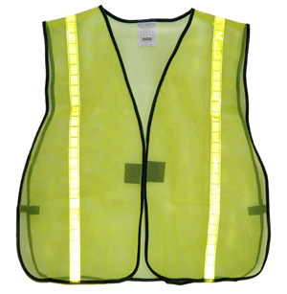
Provide first response assistance
Area Wardens:
Commence evacuation and implement emergency procedures in their area
Communicate with Chief Warden
Direct ‘Wardens’
Provide ongoing/updated advice to Chief Warden
Provide list of these to be accounted for
Confirm persons accounted for
warden
Notes:
Trainer continues identifying positions in sample chain of command and attendant responsibilities:
Area Wardens
In an emergency Area Wardens should:
Commence evacuation if circumstances in their area warrant it
Implement the emergency procedures for their area
Communicate with Chief Warden and follow instructions received
Direct Wardens under their control to check area for any abnormal situation
Advise Chief Warden of circumstances and actions taken
Provide lists of people to be accounted for
Confirm persons are accounted for.

Slide 27
Provide first response assistance
Wardens:
Take place of Area Wardens if they are absent
Notify emergency services
Conduct searches
Facilitate evacuation
Control people at evacuation assemble points
Operate fire-fighting equipment
warden
Notes:
Trainer continues identifying positions in sample chain of command and attendant responsibilities:
Wardens
In an emergency Wardens may:
Act as Area Wardens in their absence
Notify the fire brigade or other emergency service
Search the area to ensure persons are accounted for
Ensure orderly evacuation to Evacuation Assembly Areas
Assist mobility impaired persons
Maintain control of persons at Evacuation Assembly Area
Operate first attack fire fighting equipment if trained to do so.

Slide 28
Provide first response assistance
First Aid Personnel:
Report to Warden/s
Assist in removal of impaired persons
Render first aid
Communicate with Area Warded regarding action taken
Record first aid provided
Notes:
Trainer continues identifying positions in sample chain of command and attendant responsibilities:
First Aid Personnel
In an emergency, First Aid Personnel should:
Report to the relevant Warden
Assist the Warden with mobility impaired persons
Render first aid to injured persons when safe to do so
Communicate with the Area Warden regarding actions to be taken
Record first aid actions taken.
Class Activity – Guest Speaker
Trainer arranges for Chief Warden from a venue to attend and talk to students about:
Chain of command at their workplace
Positions, roles and responsibilities
Training provided
Communication between those involved
How the ‘system’ works.

Slide 29
Summary – Element 1
When responding to fire and other alarms:
Respond promptly
Never assume an alarm is a false alarm
Identify nature and location of alarms
Notify others immediately – internally and externally
Get help moving your way as soon as possible
Put ‘notifying others’ and ‘obtaining assistance’ before taking other ‘first response’ action
(Continued)
Notes:
Trainer provides a recap of the Element asking questions to check trainee understanding and responding to questions from trainees, as required.

Slide 30
Summary – Element 1
Never put yourself in danger
Put safety of people before safety/security of property
Facilitate arrival and access of emergency services
Provide first response action in accordance with training, resources available and common sense
Never re-set or turn off an alarm until specifically told to do so by management or another appropriate person
Notes:
Trainer provides a recap of the Element asking questions to check trainee understanding and responding to questions from trainees, as required.

Slide 31
Respond to safety threats
Performance Criteria for this Element are:
Manage patrons who are displaying inappropriate behaviour
Make safe areas that are identified as being unsafe
Respond to suspicious packages
Respond to bomb threats
Notes:
Trainer identifies for trainees the Performance Criteria for this Element, as listed on the slide.
Class Activity – Discussion
Trainer asks trainees questions about responding to safety threats by asking questions such as:
What are examples of safety threats?
What do you think is ‘inappropriate’ patron behaviour?
How might you identify a suspicious package?
How would you respond if someone told you there was a bomb in the building?

Slide 32
Manage patrons displaying inappropriate behaviour
You must manage patrons who display ‘inappropriate behaviour’:
The interpretation of ‘inappropriate behaviour’ may vary:
Between properties
Between different sections of the same venue
At different times of the day
Notes:
Trainer advises students:
You will be required to manage patrons who are displaying inappropriate behaviour
There is potentially quite a difference between what venues determine to be ‘inappropriate behaviour’
One venue may be far more lenient than another in defining what is acceptable and what is not
There is also potentially a variation between acceptable and unacceptable standards:
Within the one venue – requirements in a bar may be different to requirements for behaviour in a restaurant; requirements in a night club will be different to acceptable standards at reception/in the main foyer or lobby area
At different times of the day – the requirements in the same area can be quite different at 10:00PM than they were at 10:00AM.

Slide 33

Manage patrons displaying inappropriate behaviour
Inappropriate behaviour includes:
Aggressive, rude and anti-social behaviour
Arguing
Refusing to leave
Intoxication
Intimidation
(Continued)
Notes:
Trainer gives examples of inappropriate behaviour may include:
Aggressive, rude and anti-social behaviour by patrons or members of the public who are on the premises
People arguing with other patrons or staff
Patrons/people who refuse to leave the premises when asked to do so
Patrons/people who are intoxicated on the premises
Anyone who intimidates, or attempts to intimidate, anyone on the premises.

Slide 34

Manage patrons displaying inappropriate behaviour
Violent behaviour
Swearing and abusive language
Improper/unacceptable dress
Too many guests in a room
Excessive noise
Notes:
Trainer continues giving examples of inappropriate behaviour may include:
Any person committing an act of violence in the venue
People who swear or use any form of abusive language – including racist and/or sexist terms
Customers who fail to meet required dress codes for certain parts of the venue
Rooms in which there are ‘too many’ guests – for example, a room sold for two people but where evidence exists there are more than this sleeping in the room
Noisy patrons.
Class Activity – Discussion
Trainer leads discussion on:
When behaviour is acceptable and unacceptable
What differentiates between acceptable and unacceptable behaviour
Why the one thing may be acceptable in one instance but unacceptable in another.

Slide 35
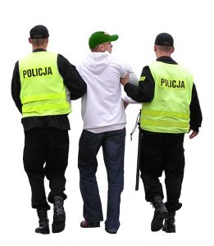
Manage patrons displaying inappropriate behaviour
Responses to inappropriate behaviour:
Move close and look in the direction
Speak to those involved – ask them to modify language and or behaviour
Move people
Advise patrons what is required (acceptable and unacceptable)
Communicate with supervisor
Notes:
Trainer presents ways to respond to inappropriate behaviour:
Moving closer to the ‘situation’ and looking in the direction those involved – let people know you are monitoring/watching
Having a word with those involved and asking them politely to modify their behaviour/language
Escorting persons away from the area or out of the venue
Advising patrons of what is expected and acceptable
Communicating with control/supervisor and informing them of developments including:
Seeking permission to act
Seeking advice on what to do
Requesting back-up.
Class Activity – Demonstration and Practical/Role Plays
Trainer demonstrates implementation/application of ways to respond to inappropriate behaviour as listed on the slide and provides opportunity for students to do the same.

Slide 36
Manage patrons displaying inappropriate behaviour
Other considerations:
‘Nip it in the bud’
Do not rely/act on ‘hearsay’ evidence
You are NOT a Police officer
Notes:
Trainer advises students of additional points to note when managing patron behaviour:
Nip it in the bud
The golden rule in relation to managing patrons who are displaying inappropriate behaviour is all potentially troublesome situations must be 'nipped in the bud’. This means no situation should be allowed to go un-checked or un-addressed if it has the potential for harm, offence, abuse or contravenes the venue standards for suitable/acceptable behaviour.
It is vital you realise in a public situation you and everything you do, or do not do, is on public show: if you allow one person to ‘get away with something’ you are automatically sending a message to the others who see or hear this they can get away with it too. By the same token, when you intervene to control a situation you are similarly sending a message to everyone that such behaviour or language will not be tolerated.
‘Hearsay’ evidence
It is standard industry practice not to act on hearsay evidence when responding to a complaint about unacceptable patron behaviour/language.
Hearsay evidence are allegations or assertions made by customers that certain things happened such as:
A person jumped the queue
A person used bad or offensive language
A person was rude
A person committed an offence.
Most venues will require you to have first-hand evidence something has occurred (that is, they will require you actually saw or heard it yourself) before they will authorize you to take action.
You are not a Police Officer – see following slides.

Slide 37

Manage patrons displaying inappropriate behaviour
You are not a Police Officer:
You do not have the same rights
Power/authority comes from uniform and attitude
Responses can be limited to:
Containing the situation
Calling for assistance
Protecting and defending
Notes:
Trainer urges students to understand performing security or safety-related work in a venue does not make them a police officer making the following points:
They do not have the same rights as a police officer.
They do not have the same right to stop people or to demand their name. They may, of course, request it/ask for it but people do not have to comply.
As already stated your rights as a security officer are, in reality, no more than the rights of the ordinary citizen.
‘Power’/’authority’ often comes from:
The fact you are in uniform – and most people respect the uniform
Your demeanour/attitude and appearance – and sometimes your size.
The reality of many security jobs is if a problem occurs your job is to:
Contain the situation to the best of your ability – by, for example:
Moving people away from the situation
Restricting access to an area
Call for assistance from external security or local authorities
Protect and defend – always put the protection of lives/people above the protection of assets/physical resources (including cash).
Class Activity – Guest Speaker
Trainer arranges for local Police officer to attend and:
Discuss legal rights/limitations regarding what Security staff can and cannot do
Offer suggestions for dealing with situations
Identify how to summon police assistance.

Slide 38

Manage patrons displaying inappropriate behaviour
In relation making an arrest/citizen’s arrest:
Don’t!
Delay the person instead until Police arrive:
Engage them in conversation
Ask them questions
Give them a drink/snack
Ask them to wait
Notes:
Trainer discusses topic of staff making an arrest offering:
They should avoid doing this – as there are too many possible legal implications (being sued for wrongful arrest or similar)
They should instead try to delay the person identifying strategies to delay ‘offenders’ until police arrive can include:
Engaging the person in conversation – to distract them/keep them ‘on scene’
Asking them questions – which again occupies them and keeps them present
Providing them with a drink or something to eat
Asking them to wait for the police to arrive.
Class Activity – Demonstration and Practical
Trainer:
Demonstrates techniques to delay an offender until police arrive
Provides opportunity for students to practice same.

Slide 39

Make safe unsafe areas
Unsafe areas are:
Areas which pose a risk to the safety of people
Areas which, if left as they are, could cause damage
Notes:
Trainer identifies unsafe areas as:
Areas which pose a risk to the safety of people – including:
Guests/customers
Members of the public
Staff
Areas which, if left as they are, may cause damage to:
The venue
Assets and/or property.

Slide 40
Make unsafe areas safe
Examples of unsafe areas:
Damaged structure
Spillages
Malfunctioning plant and equipment
Parts of the venue impacted by environmental issues
Emergency situations
Notes:
Trainer provides examples of unsafe areas:
Areas where people are fighting or engaging in threatening or otherwise potentially dangerous behaviour
Situations where the building presents a danger – such as:
Broken windows
Spilled liquids on the floor
Items which have been dislodged and are in danger of falling
Machinery of equipment which is malfunctioning and creating the potential for explosion, fire or other injury
Circumstances where the weather or local environment presents a threat – such as:
Excess wind
Rain coming into the building
Smoke from a nearby fire
Fumes from a chemical spill which is close by
Emergency situations which create an unsafe area – such as:
Fire in a room – or on a floor
Gas leak in the kitchen with impact on the associated dining areas
Riots in the street outside the venue.

Slide 41

Make unsafe areas safe
Action to make safe unsafe areas:
Report the situation - immediately
Ask for assistance, if necessary
Determine if an alarm needs to be activated
(Continued)
Notes:
Trainer provides advice about action to take to make safe unsafe areas:
Immediately report back on what you have found – advising:
Location and nature of the problem
Cause of problem – if known
Possible impact – in terms of:
People likely to be impacted
Nature of the impact
Impact site/s
Seek assistance/notify the relevant person where necessary – to:
Get assistance moving towards you
Initiate any programmed internal response – such as implementing an Emergency Management Plan for the specific type of issue which has been identified
Determine if there is need to activate an alarm

Slide 42

Make unsafe areas safe
Take action – such as:
Close (or open) doors, gates, windows
Erect barricades
Prevent access to affected/danger areas
Direct people to move to safety
Remove the cause of the danger
Stay ‘on scene’ until the problem is resolved
Notes:
Trainer continues providing advice about action to take to make safe unsafe areas:
Make safe unsafe areas to the best of your ability as possible ‘at the time’ – by taking basic actions such as:
Closing/locking doors, windows and/or rooms
Erecting barricades to prevent access
Restricting access to unsafe areas by directing people elsewhere away from the danger and out of harms’ way
Directing people to move away – and advising where to go and how to get there
Physically removing dangerous items – only where this is totally safe to do so
Remaining in place to provide a physical presence/deterrent – and to stop people entering the dangerous/unsafe area
Turning on lights – to:
Deter people who should not be there
Give people light by which to see where they are going
Class Activity – Role Play
Trainer conducts role play asking students to:
Address an unsafe situation – including:
Reporting same
Determining action to take
Asking people to move away
Protecting the area.

Slide 43

Respond to suspicious packages
It is vital:
You look actively for suspicious packages
You respond immediately to them
Notes:
Trainer states all ‘suspicious packages’ must be responded to appropriately emphasising venues are more aware of the possibility of terrorist activity today more than ever before meaning staff should be aware of any packages:
Left lying around
Unattended
In a place they should not be.

Slide 44

Respond to suspicious packages
Always err on the side of caution if you believe you have identified a suspicious package – this should involve:
Notifying management
Moving people away
Contacting authorities
Notes:
Trainer urges students to always err on the side of caution when they think you have identified a suspicious package and never be afraid of:
Notifying management – and getting a supervisor/manager involved in the situation
Clearing people away – which may be to the outside of the building
Contacting the authorities.

Slide 45

Respond to suspicious packages
Response to suspicious package:
Do not touch it
Try to identify owner
Contact police or management – according to house protocols
Evacuate people
Turn off electronic equipment
Notes:
Trainer states where a suspicious package is identified, the appropriate response is:
Do not touch it – leave it alone
Make immediate local enquiries to see if you can identify the owner – the owner may have just wandered away, be speaking to staff at reception or be at the bar obtaining a drink
Phone the police and report the finding – stay on the line until told to hang up: answer the questions asked to the best of your ability.
Internal requirements may you to notify management first: adhere to venue policy in this regard.
Evacuate people from the immediate area – you may elect to evacuate people from a wider area depending on the nature of what you have found
Turn off anything likely to trigger an explosion, such as mobile phones, pagers, electronic devices.
Class Activity – Guest Speaker
Trainer arranges for Police representative to attend and discuss with students the accepted/approved local response to a ‘suspicious package’.

Slide 46

Respond to suspicious packages
Additional points to consider:
There is no definition of a suspicious package
Leave action and decisions to the experts
Emergency services will know what to do
It is better to be safe than sorry
Terrorists rely on your lack of observation and inaction
Notes:
Trainer presents additional points to consider when faced with a suspicious package situation:
There is no such thing as a definition of a suspicious package – many items which do not look suspicious have, in fact, concealed a device that has exploded.
There are indications a package may conceal a device – and experts know what to look for. You are not an expert.
The problem is if you examine a package and believe it has no tell-tale signs it is a bomb, you may move it and by so doing, detonate it.
It is for this reason these notes have deliberately omitted information about what signs to look for.
You are urged to treat every suspicious package with the utmost care and respect: follow the advice given above.
When the police have been notified, they will attend and assist with evacuation, as well as determining which other services should be called in.
While you do not want to overreact to suspicious package situations, it is important to make the decision relatively quickly about whether or not 'a situation' exists.
Commonly individuals are reluctant to contact authorities in case there is not a problem, and they think they will then be made to look foolish – you must overcome this thought.
It really is a case of being better safe than sorry.
To get the optimum results from a bomb, terrorists rely on:
Your lack of observation to detect the package
Your reluctance to act.

Slide 47
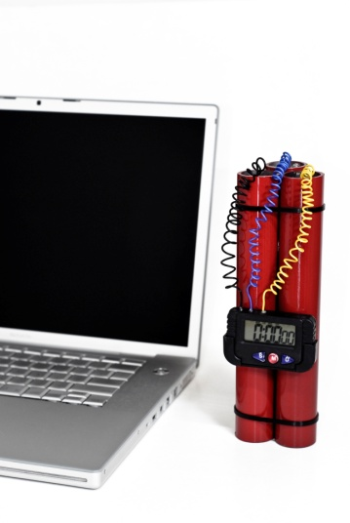
Respond to bomb threats
If you receive a bomb threat:
Stay calm
Listen attentively
Use a ‘Bomb Threat Checklist’ to record/capture details
Notes:
Trainer provides direction for students if they receive a bomb threat:
When you receive a bomb threat over the telephone, handle the call calmly
Make sure you listen attentively for issues which may help identify the caller and/or the location from where the call was made
Venues may provide a ‘Bomb Threat Checklist’ near telephones to assist in this regard.
Class Activity – Handout
Trainer distributes and discusses sample of Bomb Threat Checklist.

Slide 48
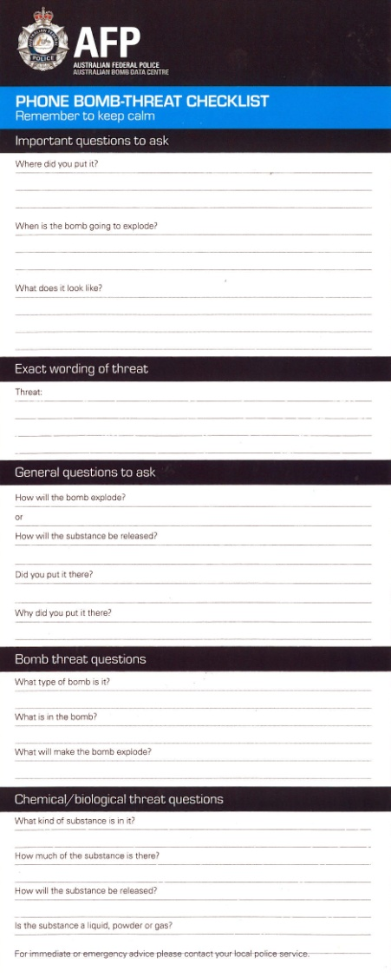
Respond to bomb threats
Details to capture/pay attention to:
Background noises
Caller details
Call details
Bomb details
Notes:
Trainer identifies details which should be captured when receiving a bomb threat telephone call:
Background noises – which may relate to:
Street and/or house noises; Aircraft noises; Music; Other voices; Machinery
Details about the caller – such as:
The caller’s accent; Gender; Age; Speed they spoke at; Speech impediments; Diction
Call details – for example:
Was it real-time or taped? Was it read from a script or made up on-the spot? Threatening? Abusive? Rational? Incoherent?
Bomb details – ask questions to try to get as much information from the caller as you can:
‘What does the bomb look like?’
‘What type of bomb is it?’
‘What is in the bomb?’
‘When is the bomb due to explode?’
‘Why did you plant the bomb?’
‘How can we defuse it?’
‘What will make the bomb explode?’
Class Activity – Role Play/s
Trainer develops series of role plays where students are required to take mock telephone call advising there is a bomb in the venue.
Students should ask questions and capture relevant details of the call.

Slide 49
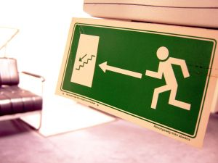
Respond to bomb threats
After taking the bomb threat telephone call:
Speak with management/designated venue person
Talk to them so others cannot overhear
Stay clam and speak clearly
Start evacuation
Never think the call was a hoax
Notes:
Trainer advises students about what to do after taking a bomb threat telephone call:
Immediately speak with the appropriate person about the threat – supervisor, owner, Head of Security
Talk in a quiet place away from others
Communicate the details in a calm and clear manner – to avoid panic: refer to the notes taken at the time
Immediately start evacuation procedures
Never think the call was a hoax – it is not worth risking lives if your thinking was wrong: let management or the authorities make the decision on this.

Slide 50
Summary – Element 2
When responding to safety threats:
Respond promptly – nip problems in the bud
Obtain first-hand information wherever possible
Be proactive
Remember you are not a police officer
Avoid making arrests
Never put yourself in danger
(Continued)
Notes:
Trainer provides a recap of the Element asking questions to check trainee understanding and responding to questions from trainees, as required.

Slide 51
Summary – Element 2
The safety of people takes priority over safety of property
Take action to make safe areas identified as being unsafe
Limit any adverse impacts or damage
Respond positively to suspicious packages
Treat all bomb threats as genuine
Notes:
Trainer provides a recap of the Element asking questions to check trainee understanding and responding to questions from trainees, as required.

Slide 52
Respond to emergency situations
Performance Criteria for this Element are:
Identify the nature and scope of the emergency
Contact emergency services
Implement the Emergency Management Plan for the premises
Provide first response assistance
Maximise safety of personnel during the emergency
Notes:
Trainer identifies for trainees the Performance Criteria for this Element, as listed on the slide.
Class Activity – Discussion
Trainer asks trainees questions about responding to emergency situations by asking questions such as:
What is an Emergency Management Plan?
How might you respond to an injured patron?
Why might you contact Police for assistance?
What information would you give the fire services if you had to call them to attend a fire at your workplace?
What is meant by ‘first response’ assistance?

Slide 53

Identify nature and scope of emergency
When an emergency occurs you must:
Identify nature and scope so you can:
Pass on information to others
Determine action to take
Notes:
Trainer states when faced with an emergency it is necessary to first identify the nature and scope of the situation explaining this is necessary to :
Pass on correct information to others – staff, guests and emergency services
Determine the most appropriate course of action to take.

Slide 54
Identify nature and scope of emergency
Hotels are unique locations for emergencies:
Open 24/7
People may have been drinking alcohol
Guests may not be familiar with their environment
They may be asleep
May be spread over a large and diverse range of areas
Notes:
Trainer informs students it is worth remembering the following about hotels and emergencies:
The hospitality industry is a unique industry – it is often operational twenty-four hours/day, seven days a week; it is open to the public and it commonly has numerous people (guests, workers, visitors, delivery people, service technicians) on the premises.
All this plus it is an environment where:
People consume alcohol
Guests are often in an unfamiliar environment
They may be asleep when the emergency arises.
In addition, many venues are spread over quite large areas featuring:
Outside public areas - car parks, gardens, pools, walkways, entertainment areas
Numerous internal spaces – bars, guest rooms, function rooms, entertainment areas, spa facilities, gymnasiums, pools, kitchens, dining areas, offices, store rooms
Multi-level buildings
All of these factors combine to produce a situation where almost any type of emergency could arise
This is distinctly different to many other industries where they are able to more clearly identify a more limited range of emergencies that could occur.

Slide 55
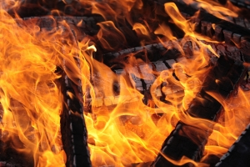
Identify nature and scope of emergency
Emergency situations can include:
Fire
Medical emergency
Gas leak
Bomb threat
Hostage situation
(Continued)
Notes:
Trainer identifies different types of emergencies (which have already been identified) could include, but are not limited to:
Fire – in a public area (internally or externally), in a kitchen, in the ironing/linen room, in a guest room
Medical emergency – such as the collapse of a guest, an injury to staff or guests caused by an attack
Gas leak – related to cooking, heating or other appliances giving rise to the possibility of explosion and/or fire
Bomb threat – creating a situation where most establishments will automatically initiate a full evacuation of the premises and the involvement of emergency services
Hostage situation – necessitating the involvement of authorities and the removal of all those who have not been taken hostage to a safe location.

Slide 56
Identify nature and scope of emergency
Chemical spill
Robbery
Deranged customers
Flood
Power failure
Notes:
Trainer continues identifying types of emergency situations:
Chemical spill – which may create a situation posing a risk from toxic fumes and the danger of burns due to contact with the chemical, explosion and/or fire
Robbery – this includes a robbery committed against the establishment as well as robberies committed against guests and staff
Deranged customers – which can include patrons who are intoxicated, those who may be affected by drugs or those who are simply being extremely difficult to deal with perhaps because of other issues (such as tiredness, unfamiliarity with their surroundings, lack of money, relationship problems, gambling problems)
Flood – which can be caused by a burst water main, or may be the result of a natural event such as a cyclone, very heavy rain or a hurricane or typhoon
Power failure – a power failure provides the potential for many emergencies: in itself the power failure rarely creates an emergency but it can produce circumstances making it more likely other emergencies will arise such as people trapped in elevators, thieves who take the opportunity to commit a crime because they believe there is less chance of being caught, guests slipping or tripping because there is insufficient light to enable them to see properly.
The Emergency Management Plan should have investigated possible emergencies identified as being likely to occur and taken appropriate planning action for each of them.

Slide 57
Identify nature and scope of emergency
To determine scope of the emergency:
How many people are involved/in danger?
Who is available to assist?
Can you deal with the situation on your own?
(Continued)
Notes:
Trainer explains critical factors in deciding what the extent of the emergency is can include consideration of the following questions:
How many people are in danger/likely to be affected? All lives are valuable, but the more people who are potentially affected, the more urgent the situation and the greater the extent of the emergency
Who is available to help you – immediately? If most of the staff are away (such as on night shift) and there is little in the way of immediate support within the establishment, the more urgent the situation and the greater the extent of the emergency
What is the possibility of you being able to deal successfully with the situation on-the-spot (after notifying others of the problem)? If you believe the emergency is too big for you to deal with, the more urgent the situation and the greater the extent of the emergency.

Slide 58

Identify nature and scope of emergency
What are others doing?
How are others behaving?
What other factors could impact or make matters worse?
Always adopt ‘worse case’ scenario.
It is best to call for help before taking any other action.
Notes:
Trainer continues listing questions which need to be answered to identify scope of an emergency:
What are others doing? You may notice a situation where others are working to address the emergency and appear to be succeeding, but you may also notice everyone just appears to be standing around watching what’s going on despite the imminent danger to themselves
How are other behaving? Where people appear to be, for example, evacuating effectively and quickly in a quiet and orderly fashion this a vastly different set of circumstances to a situation where they are rushing about in panic, returning to their rooms to collect personal belongings when there is a fire, or standing in the one place crying
What are other associated factors that could make the situation worse? If there is a fire next to a gas tank this is more serious than a rubbish bin on fire next door to the outside swimming pool. If the wind is blowing in your direction and the place next door is on fire, this would also be a concern, or if you know all the guests on the top floors are frail and elderly people (or children) this poses more of a problem than if they were fit, young athletes.
The key to determining the full extent of the emergency in a venue is therefore to obtain as many relevant facts about the situation as you can, and use those facts together with your knowledge of the establishment (location of equipment, layout, available staff) and common sense to make a decision.
It is always best to adopt a ‘worse case’ scenario.
You are better off calling fire authorities for a small fire you manage to extinguish yourself before they arrive, than delaying placing the call for help and having the venue burn to the ground.

Slide 59
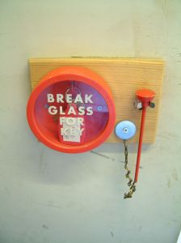
Contact emergency services
Ways to contact emergency services:
By landline or cell phone
Using direct line
Notify management
Activate an alarm
Notes:
Trainer reminds students fundamentals in relation to contacting emergency services will/may relate to using options available with in the venue for emergency response – these may include:
Make telephone contact (using landline phone or cell phone) with them as required by the type of alarm – for example:
Fire alarm or smoke detector alert requires contacting the fire brigade
Intruder alarm requires contacting police
Use direct lines to authorities or security companies – some venues have dedicated lines linked directly to emergency services or a central ‘command and control’ remote site operated by an external security company
Contact management – this relates to contacting your supervisor or the Duty Manager at the time.
The protocols which have been developed in the venue will then require that designated person to automatically contact emergency services as required by:
The type/nature of the emergency
The requirements of the EMP
Activate an alarm – many of these will automatically contact/alert:
A remote site – such as a control room, monitoring room or private security company
Emergency services.

Slide 60


Contact emergency services
Emergency services telephone numbers:
Know them in advance
National or local number?
Post numbers near telephones
Enter into cell phones
Enter into speed-dialing
Notes:
Trainer reminds students about emergency services telephone numbers stating:
It is important to know the telephone numbers for all emergency services in advance.
You do not want to waste time when an emergency has occurred looking up the number
The emergency telephone numbers for all emergency services should be:
Posted in various locations throughout the venue – especially near telephones
Entered into your cell phone
Entered into speed-dialling facilities of landline telephones
Be aware your emergency services telephone numbers may be:
A national number – which can be called form any location/town/city in the country
A set of local numbers – giving you direct contact with the nearest emergency services facilities/stations.

Slide 61

Contact emergency services
When telephoning to report an emergency:
Identify yourself, position and venue location
Say you want to report an emergency
Describe the emergency
Be guided by the operator
Give location of the emergency
Notes:
Trainer reminds students when reporting an emergency they should:
Identify yourself, position (bar attendant, Duty Manager, security staff) and venue location
State you are reporting an emergency
Describe the nature of the emergency
Be guided by the operator on the other end of the phone – as to what to do and the information to provide
Give the location of the emergency within the venue – Room number, Ballroom, cleaning cupboard on 2nd floor.

Slide 62

Contact emergency services
Identify threat
Identify numbers involved
Describe relevant local factors
Advise approach/entrance
Advise what you think is required
Do not hang up until told to do so
Notes:
Trainer continues reminding students on how to report an emergency to emergency services using the telephone:
Identify the threat you believe is being posed
Define the numbers of people threatened/involved – people trapped; building has collapsed
Describe any local factors relevant to the emergency – power out; escaping gas; internal comms system not operational; venue very busy/crowded
Advise of best approach or entrance to use
Give your opinion regarding the action required
Never hang up until told to do so.

Slide 63

Implement Emergency Management Plan
You must discharge the roles and responsibilities for your position if an emergency arises as stated in the EMP – pre-requisites for doing this are:
Read and understand plans
Clarify anything you are unclear about
Talk to others
Take part in training and drills
Notes:
Trainer advises students are expected to discharge their allocated responsibilities as set out for their position in the EMP for the venue highlighting in order to follow the EMP (or Emergency Action Plan) they must:
Obtain, read and understand the plan for your position
Query/clarify any points which are unclear
Talk to others about their roles and responsibilities
Participate in EMP training sessions
Participate in venue emergency and evacuation drills and practice sessions.

Slide 64
Implement Emergency Management Plan
Follow EMP where applicable but use common sense – if you need to depart from the plan:
Seek approval
Aim for greatest good for the greatest number
Notify chain of command of action taken and or action to be taken
Notes:
Trainer states the EMP must provide the basis for action/response however students are expected to use common sense where the plan cannot be adhered to and/or when circumstances dictate indicating where they have to vary the action/response taken:
Seek approval for the action, if possible, before taking it
Always seek the greatest good for the greatest number
Notify the chain of command about what you intend/have done.

Slide 65
Implement Emergency Management Plan
Important actions:
Act quickly
Activate alarm
Notify emergency services
Contact internal person/s
Notes:
Trainer reinforces previous advice:
Many disasters have occurred because everyone thought someone else had taken this step
When an emergency situation has been identified, speed in responding is critical
The biggest problem with responding effectively to an emergency lies in the first one or two minutes when staff waste time determining whether or not they need to do something, and/or working out what they should do
It is essential to act/respond quickly by:
Activating an alarm
Contacting a nominated internal person
Notifying external authorities.

Slide 66
Implement Emergency Management Plan
Next You should:
Implement your EMP role
Assist others
Perform ‘first response’ activities
Evacuate those in danger
Notes:
Trainer states when activities listed in previous slide have been undertaken they should:
Implement your role in the EMP
Assist others – staff and/or guests; emergency services
Engage in first-attack response where safe to do so
Evacuate people to the designated Evacuation Assembly Points.

Slide 67

Implement Emergency Management Plan
You may be required to wear nominated clothing when an emergency is declared to indicate they are staff at the venue and what their role is.
Clothing may include:
Colour-coded hard hats
Colour-coded vests
Notes:
Trainer explains staff uniforms will serve as an indicator people are an employee of the venue and this gives some initial status as someone ‘in charge’ and able to give directions to people when an evacuation is required but when an emergency is declared staff may be required to wear:
A nominated hat – different colours indicate the role of the person wearing it
A coloured vest with your role written on the vest.
This indicates to both members of the public, other staff and emergency workers what your role – and hence your potential knowledge, skills and abilities may be.
Class Activity – Samples
Trainer shows examples of colour-coded hats and vests to students.

Slide 68
Implement Emergency Management Plan
Follow chain of command directions:
Promptly
Completely
Without question – unless there is good reason not to do so
Notes:
Trainer explains students role is to not only follow the actions prescribed for them in the EMP but also comply with chain of command directions during the emergency:
Promptly
Completely
Without question – see later slides ‘Questioning command directions’.

Slide 69
Implement Emergency Management Plan
When giving instructions in an emergency situation:
Know what you are talking about
Speak clearly, calmly but with authority
Do not panic
Try not to shout
(Continued)
Notes:
Trainer suggests when giving instructions to guests in an emergency situation the requirements to follow are:
Ensure you know what you are talking about – giving incorrect information causes confusion and can result in deaths or injury
Speak clearly and calmly but with authority – speak as if you expect people to comply with what you say
Do not panic – if you panic this will cause panic in others: likewise if you are calm this will create calmness in others
Try not to yell – unless background noise makes this necessary.

Slide 70
Implement Emergency Management Plan
Exude confidence
Repeat directions/instructions
Use hand signs/signals
‘Show’ instead of just ‘telling’
Notes:
Trainer continues providing advice when giving instructions/directions yo guests in an emergency:
Exude confidence – this gives reassurance and helps maintain control and eliminate panic
Repeat yourself – often/as necessary
Use appropriate sign language and signals
Be prepared to ‘show’ and not just ‘tell’.
Class Activity – Demonstration and Practical (Role Plays)
Trainer demonstrates how to give directions and instructions to ‘guests’ during a mock emergency situation and provides an opportunity for students to practice same.

Slide 71
Implement Emergency Management Plan
Notify changed circumstances when implementing EMP:
Changes in environment
Changes in numbers involved/impacted
Failure or success of first response activities
Unexpected behaviour
Notes:
Trainer stresses an emergency is a dynamic situation highlighting staff have a responsibility to notify command of the changes and alter their response to suit the changed circumstances explaining changed circumstances may be:
A variation in the environment/atmospheric conditions – increase in wind or change in direction of wind; increased smoke
An increase in the number of people involved/impacted
Failure or success of the first-attack/first response to address the cause of the emergency
Unexpected behaviour of:
People – such as panic, failure to obey directions
Resources – such as lack of resources, failure of resources, inappropriate resources)
The emergency situation itself – unexpected spread of fire, gas or fumes; explosion).

Slide 72
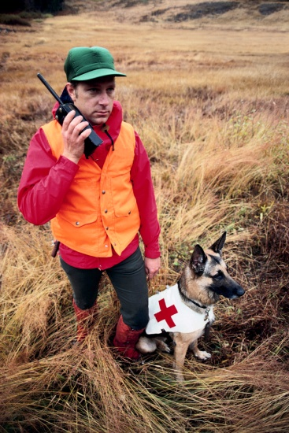
Implement Emergency Management Plan
When responding to direction given by chain of command:
Never ‘blindly obey’
Use common sense
Refuse to comply where good reason to do so exists
Advise chain of command of reasons
Notes:
Trainer states students must always use common sense when dealing with emergencies:
Follow what common sense tells you to do based on your first-hand, on-the-ground knowledge:
Explain to the person giving the direction why you think their instruction is flawed/unsafe
If the chain of command knows about the information you have supplied you are expected to do what they say unless you firmly believe it will put your safety or the safety of others in danger.

Slide 73
Implement Emergency Management Plan
Safety of people is the priority – so (for example):
Move people rather than fight the fire
Save a person instead of an animal
Protect people instead of recovering a vehicle
Notes:
Trainer stresses need to place safety of people above everything else:
Fighting a fire must wait until all people have been rescued from a ride or evacuated from the area
Saving an animal must take second place to saving a person or evacuating people
Retrieving a vehicle must never take precedence over protecting people.

Slide 74
Implement Emergency Management Plan
When emergency services arrive – they take control.
If you can help:
Ignore EMP requirements at their direction
Follow emergency services worker directions
Tell them of any special knowledge/skills you have
Leave if you cannot help
‘Support’ rather than provide first-line response
Notes:
Trainer states when emergency services arrive on scene, they take over command of the situation and staff must if able to assist emergency services:
Ignore the requirements of the EMP at their direction – the professionals may have identified a flaw in the plan as it applies to the current emergency
Follow directions given by emergency service professionals
Alert them to any relevant special training/experience you have
Be prepared to leave if you find you cannot accommodate the stated needs of the emergency services workers – for everyone’s sake you are better off out of the area under these conditions
Be prepared to act as ‘support’ rather than first-line providers.

Slide 75

Provide first response assistance
First response must always:
Be training-based
Reflect the nature and requirements of the specific emergency
Notes:
Trainer explains in the same way a fire can trigger the need to provide first response assistance so too the same requirement can apply when another type of emergency arises.
Trainer states the first response assistance must always:
Be dictated by the training you have received
Reflect the nature of the event/emergency being responded to.

Slide 76
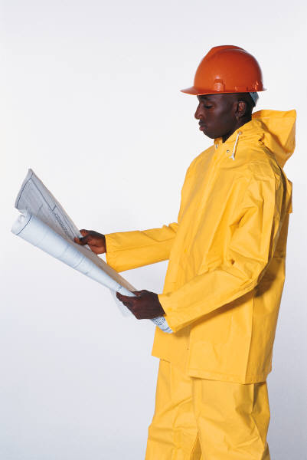
Provide first response assistance
Generic first response requirements:
Follow the plan
Respond quickly
Check others have been notified so you know help is on the way
(Continued)
Notes:
Trainer presents the following generic requirements/responses apply for first responders:
Follow the plan for responding to the situation if one exists:
It is a workplace reality plans cannot be prepared for every possible risk, threat or emergency
If time allows, access a copy of the plan to use a guide/reference – this highlights the need for you to:
Know what the plans contain
Know where they are physically located
Respond immediately – this means you must not delay:
Do not procrastinate
Do not over-think the situation
Never feel you are over-re-acting
Verify others have been notified – as already identified/described including emergency services, other staff and/or management.

Slide 77
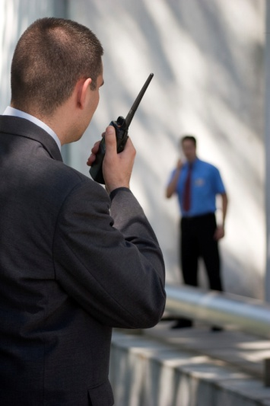
Provide first response assistance
Stay calm
Take action – see following slides
Continue to monitor the situation and provide updates
Notes:
Trainer continues presenting the following generic requirements/responses apply for first responders:
Stay calm and composed – your action/response is vital in establishing the attitude/response of others: they will be looking to you for leadership:
Do not panic or cause panic
Do not shout – speak quietly and calmly
Do not run around
Take action to address the situation: (See following slides)
Use common sense
If safe to do so
As prescribed by the relevant plan
Continue to monitor the situation – and provide up-dates to the ‘command centre’ or relevant person/warden/manager.

Slide 78
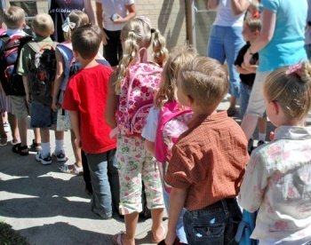
Provide first response assistance
First response actions could include:
Instruct/direct staff
Initiate auxiliary power
Record what is happening
Assist patrons
(Continued)
Notes:
Trainer explains first response action will depend on the situation with examples including:
Instructing other staff on action to take – including specification of what they should/must not do
Initiating auxiliary power/generators
Recording the situation – using camera, video or cell phone
Physically assisting guests/patrons as required.

Slide 79
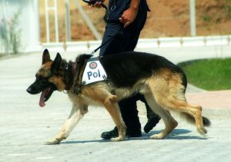
Provide first response assistance
Provide advice and direction
Conduct room and venue searches
Rescue people where safe to do so
Initiate evacuation/s
Confirm areas have been searched/are clear
(Continued)
Notes:
Trainer continues presenting possible first response actions:
Providing advice, information and directions
Conducting searches
Performing rescue duties
Initiating evacuation – or moving people to a safe area
Confirming areas have been cleared/are free of people.

Slide 80
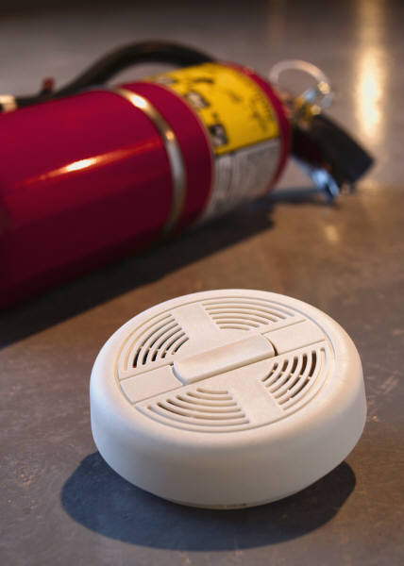
Provide first response assistance
Activate alarms
Alert patrons/guests
Provide first aid
Move people to safety
Limit damage/harm
(Continued)
Notes:
Trainer continues presenting possible first response actions:
Activating alarms
Knocking on doors/alerting room occupants
Providing basic first aid
Moving people/removing people from danger/the threat
Taking common sense action to limit damage.

Slide 81
Provide first response assistance
Close supply valves and turn off power
Close doors and windows – to stop air supply to fire
Open doors and windows – to disperse gas and toxic fumes
Prepare for emergency services arrival
Assist emergency service workers
Notes:
Trainer continues presenting possible first response actions:
Shutting off supply valves and taps – for gas
Closing/locking doors and windows – to stop air flow to fires and to prevent access
Opening doors and windows – to help disperse gas/fumes
Preparing for arrival of emergency services
Assisting and complying with directions from emergency workers.
Class Activity – Small Group Work
Trainer describes an emergency situation (fire, gas leak, deranged person, assault) in the training facility and asks students to prepare a list of their responses, in priority order, to the situation.

Slide 82
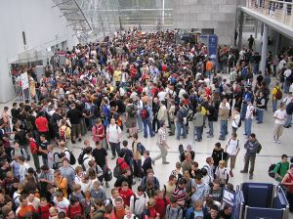
Maximise safety during emergency
Personnel whose safety needs to be maximised during an emergency:
Guests and customers
Staff
Members of the public
Anyone on the premises
Notes:
Trainer identifies personnel whose safety needs to be maximised during an emergency:
Guests and customers
Staff
Members of the public
Anyone on the premises – which may include:
Delivery drivers
Service technicians
Contractors
Visitors.

Slide 83
Maximise safety during emergency
Actions which will help maximise safety of personnel:
Maintain personal safety
People must take priority over things/assets including cash
Contain the situation
Restrict access
Control access and entry points
(Continued)
Notes:
Trainer identifies action to take to maximise safety of personnel during an emergency:
Never putting yourself in danger – you have an obligation to yourself and others to keep yourself safe
Making the safety of people takes priority over the safety/security of people’s belongings or venue assets
Containing the situation – by taking whatever action is appropriate to maintain safety of personnel while limiting the spread of the problem and/or reducing its impact on the venue
Restricting access by people to the affected area (which may require the use of ‘reasonable force’) – by:
Closing doors, gates and barriers
Locking doors and access
Putting ‘Do Not Enter’ or ‘Do Not Cross’ tape in place
Erecting barricades
Controlling access and exit points – to make sure only authorized persons gain entry. ‘Reasonable force’ can be used to do this.

Slide 84
Maximise safety during emergency
Move among and talk to people
Key off elevators
Reverse direction of escalators
Provide a physical presence
Obtain additional assistance if required
(Continued)
Notes:
Trainer presents examples of action to maximise security during an emergency:
Mixing with, moving amongst and talking to guests/members of the crowd
Keying off elevators – so they cannot be used
Reversing the direction of escalators – to limit access between floors
Providing a physical presence – which will deter people from engaging in illegal or unwanted activities
Obtaining additional staff to assist with requirements.

Slide 85
Maximise safety during emergency
Verbally direct people:
Where to go/not go
What to do/not do
Use loud hailer or PA where necessary
Notes:
Trainer presents examples of action to maximise security during an emergency:
Verbally directing people – about:
Where they can and cannot go
What they can and cannot do
Using loud hailer/megaphone or PA system to assist with providing information/direction.
Class Activity – Excursion
Trainer arranges visit to local venue to observe training and/or an emergency drill so students can gain first-hand experience of workplace activities in this regard.

Slide 86
Summary – Element 3
When responding to emergency situations:
Never put yourself in danger
Establish the nature and scope of the emergency
Contact the emergency services as appropriate
Notify internal personnel as required
Make sure you have participated in emergency and evacuation training and drills
Implement relevant EMP
(Continued)
Notes:
Trainer provides a recap of the Element asking questions to check trainee understanding and responding to questions from trainees, as required.

Slide 87
Summary – Element 3
Activate alarms as appropriate/necessary
Use common sense
Adhere to chain of command protocols
Respond quickly
Give clear directions to guests
Safety of people takes priority over property
Perform search and rescue tasks
Take action to maximise safety of personnel
Regular and effective communication is critical
Notes:
Trainer provides a recap of the Element asking questions to check trainee understanding and responding to questions from trainees, as required.

Slide 88
Conduct evacuations
Performance Criteria for this Element are :
Adhere to the requirements of the internal Emergency Management Plan for the premises
Maintain calm
Determine the evacuation routes to be taken
Check for persons left in the premises
Account for those who have been evacuated
Notes:
Trainer identifies for trainees the Performance Criteria for this Element, as listed on the slide.
Class Activity – Discussion
Trainer asks trainees questions about conducting evacuation by asking questions such as:
Have you ever been involved in an evacuation from a building?
Why did it occur?
What happened to facilitate the evacuation?
What are the objectives of an evacuation?
Why do venues conduct evacuation drills?
What problems are likely to occur when an evacuation occurs?
What special problems exist when an evacuation needs to be conducted late at night or early in the morning?

Slide 89
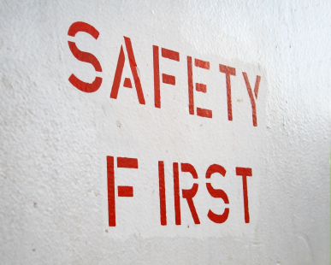
Adhere to EMP requirements
In relation to EMPs:
You must implement them in the event of an emergency
They provide guidelines about action to take
Follow your workplace EMPs where they differ from these notes
Notes:
Trainer explains:
When an emergency situation arises you are expected to implement the EMP for the premises
EMPs provide the basis for practising and conducting appropriate responses to emergencies including evacuations
For EMPs to be relevant to individual workplaces, specific workplace factors must be identified and integrated into the sample plans/direction provided in these notes
The directions given in the EMP must be the basis for action when responding to any emergency.

Slide 90
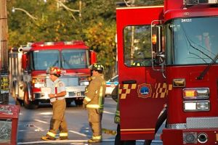
Adhere to EMP requirements
An ‘emergency’ is:
Unforeseen
A threat
Something requiring immediate attention
Notes:
Trainer identifies an emergency is:
Unforeseen – that is, not expected right ‘now’ even though it may have been anticipated ‘at some time’
A threat – to people’s lives and/or property
Something that requires immediate response – to protect lives and property.
Class Activity – Small Group Work
Trainer divides group into small groups and asks them to list emergencies for which EMPs could be prepared.
Possible answers:
Terrorist attack
Immediate personal threat situations – where staff feel threatened by customer/s
Assault emergency
Fire emergency
Gas leak emergency
Medical emergency
Bomb threat
Suspicious package
Hostage situation
Chemical spill
Deranged customer
Flooding
Robberies or armed hold-ups
Earthquake.

Slide 91
Adhere to EMP requirements
Roles of EMPs:
Guide action
Indicate sequence of action
Allocate roles and responsibilities
Provide contact details
Prescribe evacuation routes and EAPs
Notes:
Trainer explains roles of the plans are to:
Guide action in the event of an emergency
Indicate the sequence of actions to be taken
Allocate individual roles and responsibilities for taking action
Provide contact details of individuals and external organisations who may need to be involved
Prescribe evacuation routes and assembly points.
Class Activity – Guest Speaker
Trainer arranges for representative from emergency services or other relevant body to attend and:
Define and explain ‘emergency’
Discuss role of EMPs
Provide sample EMPs.

Slide 92
Adhere to EMP requirements
If you need to implement an EMP:
Always make saving people the ‘Number One’ priority
Never put yourself or others in danger
Get help – notify others
Notes:
Trainer gives basic requirements when there is need to implement an EMPO:
Always put saving of lives before saving of property
Never respond in a way that is dangerous for you or others
Get help and notify others immediately – for example:
If you have to decide between contacting the fire brigade or fighting the fire, contact the fire brigade
If you have to decide between addressing an issue or contacting the authorities, contact the authorities or a designated person within your organisation.

Slide 93

Adhere to EMP requirements
If there is a need to evacuate:
Activate ‘Evacuate Now’ alarm
Notify emergency services
Notify designated internal personnel
Notify and assist guests/customers
Notes:
Trainer states most emergencies require an evacuation of the venue, but this is not the case in every emergency so when a decision has been made to evacuate the property, four basic and critical actions must be implemented in the following order/sequence:
Activate the ‘evacuate now’ alarm. This may require:
Pushing a button
Breaking alarm glass and pushing or pulling a button, pulling a lever/handle or flipping a switch
Telling another person (by telephone or face-to-face) to activate the alarm.
Notify emergency services – refer previous notes
Notify designated internal personnel- advising them of the situation: type of issues, numbers involved, location, threat posed, action taken already
Notify and assist guests/patrons – see following slides.

Slide 94
Adhere to EMP requirements
Action to notify and assist guests/customers:
Telephone the rooms
Go to individual floors and verbally advise guests
Use a megaphone
Knock on guest doors
Inspect/check nominated areas
(Continued)
Notes:
Trainer advises the evacuation alarm will be audible to guests but staff may need to (in accordance with workplace EMP):
Telephone nominated guest rooms to advise guests
Visit nominated areas, floors, rooms, offices, departments or other locations to verbally advise people
Stand in a designated location and use a loud hailer or megaphone to notify people
Knock on guest room doors
Inspect and check nominated areas – saunas, toilets, staff rooms.

Slide 95
Adhere to EMP requirements
Escort people from area
Direct people where to go
Assist the disabled
Urge people to comply
Encourage people to leave personal belongings
Place safety of people above security of assets
Notes:
Trainer continues providing advice on what staff should do when conducting evacuations:
Escort people from an area
Show people where to go – evacuation routes and assembly points
Assist disabled people
Urge people to comply with the need to evacuate
Encourage people to leave belongings
Place the safety of people above the saving of assets, protection of property and securing of cash.
Class Activity – Role Play
Trainer arranges role play where students are required to demonstrate actions designed to assist ‘guests’ in a ‘venue’ to evacuate.

Slide 96
Adhere to EMP requirements
EMP – Responding to terrorist attack:
Notify security
Evacuate
Shut down power and equipment
Notify adjacent properties
Maintain communication
Allow professionals to do their job
Notes:
Trainer presents to trainees sample EMP contents for responding to a terrorist attack stressing where workplace requirements differ from what is presented, the workplace EMP must be followed, and highlighting:
The type of attack will determine the exact nature of the response
Attack may be via chemical weapon, bomb, firearms or other means
The EMP should include the following:
Notify venue security – who will notify authorities
Implement evacuation procedures
Shut down equipment and power
Notify neighbouring properties
Maintain communication with security
Leave dedicated responses to the professionals.
Class Activity – Guest Speaker
Trainer arranges for suitable person from an appropriate venue to visit and:
Show, share and explain their EMP for the situation listed on the slide
Provide an example of this EMP for their venue.

Slide 97
Adhere to EMP requirements
EMP – Responding to an immediate threat:
Comply with what is being demanded
Notify security
Retreat
Try to end the situation
Note details of offender
Notes:
Trainer presents to trainees sample EMP contents for responding to an immediate threat situation stressing where workplace requirements differ from what is presented, the workplace EMP must be followed, and highlighting when faced with an immediate personal threat the EMP should provide that staff:
Comply (do not resist the offender; do not delay compliance) with instructions given by offender as quickly as possible
Notify security as soon as safe to do so
Retreat if possible
Take necessary action to end the situation – which may include:
Apologise to offender
Follow directions given
Hand over money or assets as instructed
Encourage offender to leave
Note details of offender.
Class Activity – Guest Speaker
Trainer arranges for suitable person from an appropriate venue to visit and:
Show, share and explain their EMP for the situation listed on the slide
Provide an example of this EMP for their venue.

Slide 98
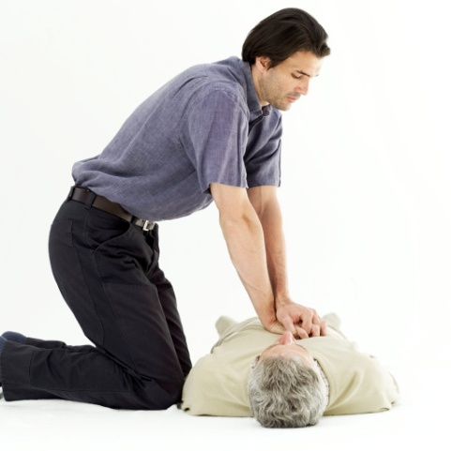
Adhere to EMP requirements
EMP – Responding to an assault emergency:
Call for internal assistance
Give basic first aid
Circulate description of attacker
Provide location of attacker
Implement ‘Respond to medical emergency’ EMP requirements
Notes:
Trainer presents to trainees sample EMP contents for responding to an assault emergency stressing where workplace requirements differ from what is presented, the workplace EMP must be followed, and highlighting the following actions should be included in an EMP for responding to an assault emergency:
Call for internal venue assistance immediately
Render basic first aid as required
Circulate description of attacker if known
Circulate possible location of attacker if known.
See also 'Respond to medical emergency' EMP (later slide).
Class Activity – Guest Speaker
Trainer arranges for suitable person from an appropriate venue to visit and:
Show, share and explain their EMP for the situation listed on the slide
Provide an example of this EMP for their venue.

Slide 99
Adhere to EMP requirements
EMP – Responding to fire:
Call emergency services
Implement evacuation plan
Notify neighbouring businesses and properties
Close doors and windows
Turn off air conditioning
Fight fire – if safe and if trained to do so
Notes:
Trainer presents to trainees sample EMP contents for responding to a fire on the premises stressing where workplace requirements differ from what is presented, the workplace EMP must be followed, and highlighting the EMP for responding to a fire on the premises should include:
Call the emergency services to report the incident – tell emergency operator the cause of the fire – if known
Implement evacuation plan for the area or for the building/venue – floors above the fire must be evacuated before lower floors
Notify neighbouring properties
Close doors and windows
Shut off air conditioning
Staff members trained to use fire equipment should use fire extinguishers and fire blankets to attack the fire if safe to do so.
Class Activity – Guest Speaker
Trainer arranges for suitable person from an appropriate venue to visit and:
Show, share and explain their EMP for the situation listed on the slide
Provide an example of this EMP for their venue.

Slide 100
Adhere to EMP requirements
EMP – Responding to a gas leak emergency:
Call emergency services
Turn off or remove ignition sources
Notify neighbours
Evacuate
Open windows and doors
Turn off gas – if safe to do so
Notes:
Trainer presents to trainees sample EMP contents for responding to a gas leak on the premises stressing where workplace requirements differ from what is presented, the workplace EMP must be followed, and highlighting the EMP should address:
Call the emergency services to report the incident – tell the operator the cause of the emergency, type of gas involved, if anyone is hurt or trapped, and if there are any further hazards that may cause explosions
Turn off or remove possible ignition sources
Notify neighbouring properties
Implement evacuation from the area or building or venue
Open windows and doors to disperse gas
The appropriate person should turn off the gas, where applicable and safe to do so – at the mains, or using stop valve.
Class Activity – Guest Speaker
Trainer arranges for suitable person from an appropriate venue to visit and:
Show, share and explain their EMP for the situation listed on the slide
Provide an example of this EMP for their venue.

Slide 101
Adhere to EMP requirements
EMP – Responding to a medical emergency:
Call an ambulance
Never assume you know the cause
Do not move the patient
Do not ‘act in hope’
Keep public away
Do not comment on the incident to anyone.
Notes:
Trainer presents to trainees sample EMP contents for responding to a medical emergency stressing where workplace requirements differ from what is presented, the workplace EMP must be followed, and highlighting ‘minor incidents’ are not considered ‘medical emergencies’ and should be dealt with using basic first aid. For serious incidents the EMP response should cover:
Call an ambulance – or notify designated person to call an ambulance
Never assume knowledge of what is wrong with a person – always seek professional medical advice
Do not move the person unless he or she is in immediate danger
Do not take any action in the ‘hope’ it might be the right thing to do
Keep spectators away from the patient
Do not comment on the incident to anyone except management or the authorities.
Class Activity – Guest Speaker
Trainer arranges for suitable person from an appropriate venue to visit and:
Show, share and explain their EMP for the situation listed on the slide
Provide an example of this EMP for their venue.

Slide 102
Adhere to EMP requirements
EMP – Responding to a hostage situation:
Secure the area
Notify designated workplace person
Communicate information about the situation
Implement evacuation
Do not try to rescue hostages
Never put yourself in danger
Notes:
Trainer presents to trainees sample EMP contents for responding to a hostage situation stressing where workplace requirements differ from what is presented, the workplace EMP must be followed, and highlighting the EMP for dealing with a hostage situation should address:
Secure the area – so others cannot be involved or put at risk
Notify the nominated workplace person of the situation
Communicate information (if known) to designated person:
Number of hostage takers
Number of hostages
Age and gender of hostages
Details of hostages (pregnant women, handicapped, foreigners)
Whether or not hostage takers are armed
Implement evacuation plan
Do not threaten the hostage takers or attempt to rescue hostages
Never place self or anyone else in harm’s way
Leave negotiations to the experts.
Class Activity – Guest Speaker
Trainer arranges for suitable person from an appropriate venue to visit and:
Show, share and explain their EMP for the situation listed on the slide
Provide an example of this EMP for their venue.

Slide 103
Adhere to EMP requirements
EMP – Responding to a chemical spill:
Call emergency services and report the situation
Provide as much detail as possible
Implement evacuation
Open windows and doors
Prevent access to area
Obtain MSDS
Contain the spill – if possible, safe to do so.
Notes:
Trainer presents to trainees sample EMP contents for responding to a chemical spill stressing where workplace requirements differ from what is presented, the workplace EMP must be followed, and highlighting the EMP should address:
Call the emergency services to report the incident
Provide the emergency operator with as much information as possible:
Cause of the emergency
Type of chemical involved (if known)
If anyone is hurt
If there are any further hazards that may cause explosions – such as gas cylinders, explosive chemicals, or live electrical wires
Implement evacuation plan
Open windows and doors to disperse fumes
Prevent people entering the affected area
Obtain Materials Safety Data Sheet for the chemical (if available)
Make efforts to contain the spill to the best extent possible.
Class Activity – Guest Speaker
Trainer arranges for suitable person from an appropriate venue to visit and:
Show, share and explain their EMP for the situation listed on the slide
Provide an example of this EMP for their venue.

Slide 104
Adhere to EMP requirements
EMP – Responding to a deranged customer emergency:
Attempt to control the situation yourself
Be prepared to contact and involve Supervisor and or Security
Remove people to a safe area
Restrict access to the area
Protect property
Notes:
Trainer presents to trainees sample EMP contents for responding to a deranged customer emergency stressing where workplace requirements differ from what is presented, the workplace EMP must be followed, and highlighting the EMP should address:
Dealing with the situation in the first instance – asking them to modify their behaviour or leave the area
Contacting supervisor – and letting them determine the appropriate course of action
Contacting security staff and asking them to deal with the situation.
Where the above options are not appropriate or have failed to successfully address the situation:
Remove other people from the area – to protect their safety
Restrict access to the area by others
Protect property from damage – after the safety of people has been optimised.
Class Activity – Guest Speaker
Trainer arranges for suitable person from an appropriate venue to visit and:
Show, share and explain their EMP for the situation listed on the slide
Provide an example of this EMP for their venue.

Slide 105
Adhere to EMP requirements
EMP – Responding to armed robbery:
Comply – do not stall; do not stare at offenders
Try to remember offender details
Call police as soon as safe and possible
Do not talk to anyone – record pertinent details
Gather witnesses
Close venue
Notes:
Trainer presents to trainees sample EMP contents for responding to armed robberies or hold-ups stressing where workplace requirements differ from what is presented, the workplace EMP must be followed, and highlighting the EMP should address:
Immediately obey the directions given by the offender
Do not try to stall them – respond quickly to what they want: give them the money – do not try to be a hero
Speak only when spoken to
Do not obviously look or stare at the offender
Try to remember anything of future use to police:
Appearances of offenders
Names they used when talking to each other
Accents, tattoos, distinguishing features
How they were dressed
Vehicle they used to make their getaway
After the robbery, call the police immediately – do not touch anything. Individually, take a moment to write down anything thought to be worthwhile
Do not discuss things with other people, as this will interfere with, and distort recollection
Gather together as many witnesses as possible
Close the venue or business
Never discuss with anyone how much money was stolen – a designated person should be the only person to speak with the media.
Class Activity – Guest Speaker
Trainer arranges for suitable person from an appropriate venue to visit and:
Show, share and explain their EMP for the situation listed on the slide
Provide an example of this EMP for their venue.

Slide 106
Adhere to EMP requirements
If there is an emergency and no EMP to deal with it:
Notify emergency services, internal staff and guests
Assess the situation
Adapt an existing EMP as best as possible/if possible
(Continued)
Notes:
Trainer explains the basis for responding to an emergency for which no EMP exists is:
Notify emergency services, internal personnel and guests/customers as soon as possible
Assess the situation – taking into account known factors and information
Adapt existing EMPs where possible to serve as the basis for a response.

Slide 107
Adhere to EMP requirements
Involve others/get their input and ideas
Ensure safety of people is main objective
Be prepared just to ‘contain’ a situation
Provide constant communication
Notes:
Trainer continues giving advice on responding to an emergency for which there is no EMP:
Involve others in deciding what needs to be done
Ensure the safety of people is the first priority
Be prepared to contain a situation rather than respond to it – meaning you may elect to limit or control the impact or spread of the threat rather than try to suppress or eliminate it
Provide constant communication to internal chain of command personnel about the progress of the threat.

Slide 108
Adhere to EMP requirements
When responding to trapped or injured people during an emergency:
Do not endanger self
Communicate
Reassure those involved
Provide first aid
(Continued)
Notes:
Trainer presents advice for response if there are trapped or injured people during an emergency:
Do not compound the situation by placing yourself in danger and also becoming trapped or injured
Communicate with chain of command personnel to advise them of the situation – numbers involved, nature of the entrapment and or injuries, location, threats faced by the trapped or injured people, immediacy of the response required
Reassure people involved – tell them they are OK, advise help is on the way, hold their hand
Provide first aid – if able and qualified to do so. At this stage the first aid may be very basic and restricted to stemming bleeding, opening and clearing airways, monitoring vital signs.

Slide 109
Adhere to EMP requirements
Secure/make safe the area
Clear rubbish and debris
Be alert to ‘live’ electricity wires
Never enter a confined space
Notes:
Trainer continues presenting advice for response if there are trapped or injured people during an emergency:
Secure the area if safe to do so – to prevent the situation becoming worse/more difficult
Clear rubbish and debris – if safe to do so: never attempt to remove:
Any items, structures or fittings supporting anything else
Items resting on victims – unless it presents an immediate threat to life
Be alert to the possibility of live electrical wires
Never enter a confined space.

Slide 110
Maintain calm
In an emergency situation:
Remain calm
How you act and respond will influence/dictate how others behave
Notes:
Trainer explains:
You must always try to remain calm when faced with any emergency situation
When implementing an evacuation/EMP you must stay calm because your attitude, response and actions will greatly influence how others behave.

Slide 111

Maintain calm
To deal effectively with people in an emergency situation:
Apply appropriate interpersonal and communication skills to help maintain calm
Provide clear instructions
Notes:
Trainer states to deal effectively with guests/customers in an emergency:
Apply appropriate interpersonal and communication skills to avoid panic and maintain calm
Provide clear instructions to guests/customers, staff and others.
Class Activity – Question and Answer Session
Trainer asks “What are appropriate interpersonal and communication skills to apply when dealing with people in an emergency situation to help avoid panic and maintain calm?”
Possible answers:
Do not panic yourself – be confident in the training and drills you have participated in: know the plans will work
Speak clearly and calmly but with authority – speak as if you expect people to comply with what you say.
Take charge.
Take control.
Do not yell – unless it is necessary to overcome another noise.
Yelling generates unease and panic.
Exude confidence – in the way you stand, talk and hold yourself
Trainer asks “What can you do to optimise potential for your instructions to be readily understood during an emergency?”
Possible answers:
Use simple words
Give brief commands – for example ‘Get out now’, ‘Go there immediately’, ‘Do not run’
Use appropriate sign language and signals – to accompany the words you use
Repeat yourself often and as necessary – never expect a single instruction, direction or command to be understood
Be prepared to ‘show’ and not just ‘tell’ – escort people, accompany them, demonstrate what is required.

Slide 112
Maintain calm
The following will help you stay calm in an emergency:
Participate in practices and drills
Do not rush
Breathe deeply
(Continued)
Notes:
Trainer suggests the following can help with staying calm during an emergency situation:
Take part in all practices and drills undertaken at the venue:
The more practice you have, the better you will be in an actual situation
Take the practice seriously – do not treat it is a joke or an inconvenience
Do not rush – certainly you have to move and act quickly but ‘rushing’ creates panic and simply does not allow you to be or stay calm
Avoid running if possible
Do not rush what you say to people
Wait for responses from people as opposed to assuming they have heard and understood what you have said
Breathe deeply – this helps oxygen get to your brain.

Slide 113

Maintain calm
Work out what to do – develop a plan
Deliberately put yourself into safe but stressful situations so you can practice dealing with it
Do a ‘stress management’ course and apply some relevant techniques
Notes:
Trainer continues providing advice which will help students stay calm during an emergency:
Work out what to do – you will be calmer if you have a plan of action.
The EMP should be your action plan.
Deliberately put yourself in (safe) situations which raise your level of anxiety – and practice:
Staying calm
Coping
Dealing with those unexpected situations.
This learning will breed confidence in yourself and your abilities when a real emergency arises.
Undertake a ‘stress management’ course – many of the techniques used to management stress can be used to help you stay calm in an emergency.

Slide 114

Determine evacuation route/s
If an evacuation is necessary:
You need to determine the evacuation route/s to be used
The EMP should provide this
You must have studied and know:
Your workplace EMPs
Everything about your venue/workplace
Notes:
Trainer states whenever there is a need to evacuate the property there is a need to determine the evacuation route/s to be used highlighting:
Your EMPs will identify ‘primary’ and ‘secondary’ routes to be used where an evacuation needs to occur – see following slides
It is vital you have spent sufficient time studying the EMPs and your workplace to ensure you:
Know the routes prescribed in the plans
Have sufficient venue knowledge for the property where you work – so you know things such as:
Where doors, gates, access and egress points are located
Which points are locked and unlocked at different times of the day
Where hallways/corridors lead to
Where the primary and secondary evacuation points (the designated evacuation assemble areas) are located
Where evacuation route posters are positioned throughout the building
Where comms devices and other emergency items (torches/flashlights, first aid kits, emergency keys, are located).

Slide 115

Determine evacuation route/s
‘Primary’ evacuation route:
Best/most effective route to take
Included in EMP
Shown in guest rooms and corridors
Will be the focus of most drills
Notes:
Trainer explains ‘primary’ evacuation route:
The primary evacuation route is the route which has been determined by management and the safety and welfare (or similar) committee as being the best, safest and most practicable route for moving people from Point A to Point B.
This route will be:
Included in the relevant EMPs
Shown on the door of guest rooms
Highlighted as part of Evacuation posters located throughout the venue
The focus of evacuation drills undertaken at the venue.
Class Activity – Handout
Trainer distributes and discusses sample plans, posters and other guest room materials which highlight evacuation routes.

Slide 116
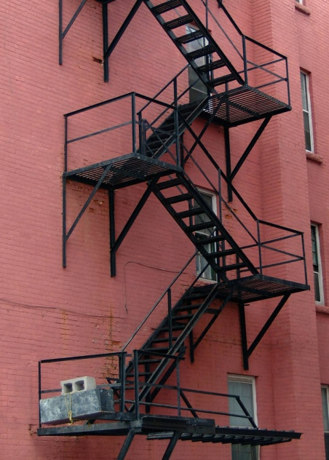
Determine evacuation route/s
‘Secondary’ evacuation routes:
This is ‘Plan B’ for evacuating
Use when ‘primary’ route is unavailable, blocked or unsafe to use
There may be one or several ‘secondary’ routes
Drills should include use of secondary routes
Notes:
Trainer discusses ‘secondary’ evacuation routes:
Wherever possible you should use the primary evacuation route if an evacuation is necessary – sometimes Sometimes, however, especially during an emergency situation it will be impossible to use the primary evacuation route
Perhaps it is blocked by fire or some structural problem with the building means it is unsafe
In these cases you will need to turn to a secondary evacuation route
The secondary evacuation route is your Plan B for evacuating the property
There may be just one secondary evacuation route or there may be several
Your training and practice (as well as the personal study you will need to undertake) will make you familiar with these alternate routes.

Slide 117

Determine evacuation route/s
EAPs = Evacuation Assembly Points:
Primary EAPs are at the end of primary evacuation routes
Secondary EAPs are at the end of secondary evacuation routes
The ‘secondary’ EAP for one evacuation route may be the ‘primary’ EAP for another route
Locations must be ‘signed’
Notes:
Trainer introduces ‘evacuation assembly points’:
Your EMPs will also identify ‘primary’ and ‘secondary’ evacuation assembly points (EAPs)
These are safe locations to which you are expected to move people when evacuating them
Primary EAPs exist at the end of the primary evacuation route
Secondary EAPs exist at the end of the secondary evacuation route/s
The secondary EAP for one evacuation route may be the primary EAP for another/alternate evacuation route
These locations may have been identified by management, relevant committees and emergency services
Signage should exist in the venue identifying:
How to get to the evacuation assembly points/areas
Location of each evacuation points.
Class Activity – Group Exercise
Trainer divides class in to two groups and asks them to develop primary and secondary evacuation routes and EAPs from a nominated location in the training facility.

Slide 118
Determine evacuation route/s
When deciding which evacuation route to use:
Primary evacuation route should be first option
Select ‘secondary’ route if primary is compromised
Refer to and rely on venue knowledge to help decide
Integrate information you have about the emergency into your thinking
(Continued)
Notes:
Trainer states when determining the route to use for evacuation the points listed below must form the basis of decision making:
The primary evacuation route should be your first choice unless you believe that route is unsafe or cannot be used
Secondary evacuation routes must be considered as the next option if the primary route is unavailable to you
Your personal knowledge of the premises and the layout of passages, doors and other relevant points must be a major factor in deciding the route to use
Integration of venue knowledge with requirements of the EMP may provide you with a viable option.

Slide 119

Determine evacuation route/s
Take a moment to consider spread of the impact of the emergency
Try to keep your options open
Realise windows can provide a safe exit strategy
Practice dealing with emergencies where primary and secondary evacuation routes are blocked
Realise back-of-house areas are valid parts of an escape route
Notes:
Trainer continues identifying points to consider when deciding which evacuation route to use:
Take a moment to consider the nature of the emergency and try to determine where the problem may spread to making sure you avoid the spread of the danger in the route you choose
Select a passage that will keep your options open to the greatest extent – a route which gives multiple exit points is mush more preferable than one with limited (or ‘zero’) options for escape
Accepting windows can be a viable exit strategy in some situations
Practice dealing with emergency evacuations where primary and secondary routes are blocked – build experience in working out effective alternate routes
Understanding during an emergency the back-of-house areas normally ‘off limits’ to guests and customers are freely available for use as an evacuation route.

Slide 120

Determine evacuation route/s
Where routes are blocked the following may be options:
Remove obstructions
Use designated secondary evacuation routes
Advice chain of command/CCC of blockage
Ask for an alternate route
Use personal knowledge and common sense to determine alternate route
Notes:
Trainer states exits, evacuation routes and stairways may become blocked or unusable during an evacuation/emergency and where this is the case responses include:
Remove obstructions where safe to do so – ask others (including guests/customers) for help where necessary
Use previously designated secondary routes
Advise chain of command about the blockage – and action (successful or not) to remove the blockage
Ask chain of command for an alternate route
Use personal knowledge to determine alternative route – advise CCC of your intentions.

Slide 121
Determine evacuation route/s
If you know/believe primary EAP is unsafe:
Use secondary EAP
Escort people to secondary EAP
Notify chain of command/CCC
Reassure evacuees
Notes:
Trainer states the nature of the emergency or the direction of the wind may render primary evacuation assembly points unsafe explaining actions in these circumstances may include:
Use the secondary evacuation assembly points
Escort evacuees to the secondary points
Notify chain of command regarding unsafe evacuation point – including:
Reasons for assembly point being unsafe
Secondary evacuation point to be used
Reassure evacuees they are safe.

Slide 122
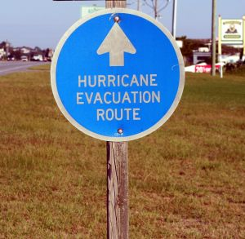
Check for persons left
All evacuations should involve a check for persons left in the building.
Planning for this should include:
Allocating responsibility for the ‘All clear’ call
Allocating specific locations for nominated people to check
Determining sequence of checks
Identifying reporting requirements
Notes:
Trainer tells students every evacuation should include a check for persons left in the premises highlighting the plans developed for emergencies and evacuations should:
Allocate responsibilities for verifying ‘areas clear’ – this means individual staff will be given specific duties to check areas to make sure no-one remains in those areas
When they have checked and verified these areas they will report this fact back to the CCC who will, in turn, pass this on to emergency services
Allocate specific locations for named staff to check – so the entire property (or all the area involved in the evacuation) has been checked and verified as ‘all clear’
Determine the sequence in which the allocated areas should be checked
Identify reporting requirements – so personnel communicate to the CCC that areas have been checked and are clear.

Slide 123
Check for persons left
Training relating to checking for people left in the building should address:
Formal drills:
Realistic
On different days of the week
At different times of the day
During quiet and busy times
Integrating ‘problems’ into the drill scenarios
Notes:
Trainer states training of staff for checking for persons left in the premises as part of an evacuation should address:
Formal evacuation drills – which have a specific focus
The focus for each drill should vary so staff are exposed to a variety of ‘realistic’ situations
Drills should be proper and detailed dress rehearsals’ rather than ‘activities’ simply designed to ‘tick the box’ for complying with legally imposed requirements to hold drills
Drills at different times of the day – with an emphasis on drills at night because most fires occur at night in accommodation venues
Drills on different days of the week – because the pattern and level of trade can vary significantly on different times
Drills during high season and low season – the requirements for handling an evacuation are remarkably different when the property is at 95% occupancy than when it is at 20% occupancy
Integration of realistic ‘problems’ into the drills – for example the evacuation drill should/could include some factor introducing an element of unpredictability or surprise into it. For example the drill may involve:
Locked doors to which keys cannot be found
People trapped in rooms
Blocked primary and/or secondary evacuation routes.

Slide 124
Check for persons left
When checking for people left in the premises:
Obtain comms devices
Obtain PPE and clothing
Follow EMP search requirements allocated to you
(Continued)
Notes:
Trainer presents points to note when checking for persons left in the premises:
Make sure you have comms before starting your search.
It is vital you can communicate with others/CCC while you are searching – this is for your own personal safety, to enable you to summon assistance for others and so you can update the status and progress of your search/checking activities.
Obtain necessary PPE and clothing before you start your search – this may include:
Hard hat/protective helmet
Coloured vest
Whistle
Flashlight
Follow the EMP requirements which have been set/allocated – this will/could involve front-of-house and back-of-house areas
Physically search all the areas for which you have been allocated responsibility – let others search the other areas.
You cannot effectively search all the areas on your own.
Advise CCC if you are unable to search any of the areas allocated to you.

Slide 125
Check for persons left
Search properly
Look behind doors
Open closed doors
Look in any area capable of concealing a human
Close doors after you have opened them
Call out as you search
(Continued)
Notes:
Trainer continues presenting points to note when checking for people left in the premises:
Make sure (as appropriate) you:
Look behind doors
Open closed doors and look inside rooms and any cabinet large enough to hold a human
Close any open doors – to help reduce flow of air to the fire
Call out as you search (for example):
“Security. Anyone here?”
“Hotel Rescue. Is anybody in here?”

Slide 126
Check for persons left
Communicate your progress – update CCC
Never put anyone at risk
Maintain your own safety
Report details of any persons found trapped
(Continued)
Notes:
Trainer continues presenting points to note when checking for people left in the premises:
Communicate your progress of searched with the CCC – tell them of each ‘clear area’ as you confirm there is no one left there
Never place anyone else at risk – do not ask them to help if their assistance would put them at risk.
Maintain/preserve your own safety at all times – never put yourself in harm’s way: never try to be a hero
If you identify people who are trapped in an area you are checking:
Determine numbers
Advise CCC of location, numbers and type of entrapped (locked door; fallen structure; flames)
Ask for assistance
Do what you can to help release those who are trapped without putting yourself in danger – CCC will allocate any remaining areas to be checked to another person.

Slide 127

Check for persons left
Communicate regarding any persons found and action taken
Maintain ‘Situational Awareness’
Notes:
Trainer continues presenting points to note when checking for people left in the premises:
If you identify people in an area you are checking:
Advise CCC you have located people
Advise CCC people are not trapped
Advise CCC of action you are taking – for example:
Leading them to safety/emergency EAP
Directing them to an exit
Maintain your Situational Awareness – monitor:
What is happening
What is being impacted
Spread of the problem
Changing circumstances
What is causing those changes
The risk you are at and the threats you are facing
How you might respond in the threats materialise into a real-life danger situation
You need to do this so you do not get trapped and so you do not become a victim.
Class Activity – Practical Activity
Trainer asks one student to ‘hide’ anywhere in the training facility and gets remainder of group to:
Organise a search
Search and find the student.

Slide 128

Account for evacuees
As part of any evacuation you must:
Account for everyone who has been evacuated
Account for everyone:
Registered as a guest
Using facilities
Known to be ‘on the premises’
Notes:
Trainer highlights:
When an evacuation has been conducted you need to:
Account for those who have been evacuated
Account for everyone:
Registered as staying in the venue as a house guest
Known to be using any facility in the venue
Known to be ‘on the premises’ at the time.

Slide 129

Account for evacuees
You need to account for people to:
Determine if people are still in the building
Confirm evacuees
Discharge ‘duty of care’ obligations
Notes:
Trainer explains need to account for people in order to:
Determine if people are still in the building – perhaps they are trapped or perhaps they are unaware an evacuation has been initiated
Emergency services will start undertaking search and rescue activities in areas you have identified people are located
Confirm people on the premises have been safely evacuated
Emergency service workers do not want to risk their lives entering dangerous areas if they know there is no reason to do so – that is, all the people have been evacuated and everyone has been accounted for
Discharge ‘duty of care’ responsibilities for the safety of guests and customers
The venue may need to be able to demonstrate/prove to a Court of law they took all reasonable precautions/actions to ensure customers and guests were safe.

Slide 130

Account for evacuees
‘Accounting for people’ means knowing where they are – they could be:
Evacuated and safe
Trapped
Unaccounted for
Notes:
Trainer states ‘Accounting for’ people means ‘knowing where they are’ explaining they may be:
Evacuated and safe – meaning they may be in an evacuation assembly area, or they may have been recorded as reaching the evacuation assembly area but have departed from there and may be:
With family of friends
In hospital
At another venue
In a safe part of your venue awaiting instructions about what to do next
Trapped – these are people who are known to be (or suspected of being) trapped somewhere in the building
Unaccounted for – meaning they are ‘absent’ or ‘missing’. It is not known if they are:
Evacuated and safe – they may have evacuated but not reported in, or been recorded by staff as having escaped
Trapped
Away from the venue – and not present when the emergency occurred.

Slide 131

Account for evacuees
To confirm numbers:
Refer to internal documents
Refer to ‘Evacuation Registers’
Refer to CCTV footage
Talk to other venue staff
(Continued)
Notes:
Trainer explains basic requirements for confirming numbers are:
Refer to internal documentation – such as:
Records of people registered as staying in the venue as house guests – all venues are required to maintain such a record
Bookings sheets for restaurants, dining areas., sports facilities, entertainment areas
Staff records – which are rosters of staff on duty at the time
Records of people registered as being present at the designated EAPs (‘Evacuation Register’ or similar)
Refer to in-house CCTV footage – to identify where possible people who left the building on their own initiative and/or without moving to designated assembly points.
Guests and customers are not under a legal obligation to assemble at the evacuation assembly points.
Talk to managers, supervisors and staff – to obtain their insight into:
Who was present at the time the evacuation was initiated
Knowledge about people who have evacuated and left the scene without being registered/recorded as having evacuated.

Slide 132

Account for evacuees
Conduct head count
Prepare list – those accounted for and unaccounted for
Liaise with emergency services
Notes:
Trainer continues explaining basic requirements for confirming numbers:
Conduct a head count – and compare ‘known numbers’ (those who can definitely/without doubt be accounted for) against the number of people known or suspected of being in the venue at the time.
Prepare a detailed list as a result of all the above which can be:
Given to authorities
Provided to CCC
Used as a reference point for follow-up activities (see below)
Liaise with emergency services – to identify any people they may have:
Rescued – and perhaps hospitalised
Identified as trapped or deceased.
Class Activity – Guest Speaker
Trainer arranges for representative from emergency services to attend and:
Explain need for accounting for people
Give advice on accounting for people.

Slide 133
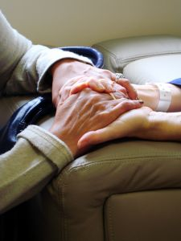
Account for evacuees
May need to provide the following for those who have been evacuated:
A reassuring presence
Medical attention
Clothing
Food and beverages
(Continued)
Notes:
Trainer highlights need to care for those who have been evacuated providing examples of what may need to be provided:
A reassuring presence:
Talking to people
Checking they are OK
Asking what they need
Giving them attention
Providing medical attention as required – which can include:
Providing first aid
Making a first aid kit available
Obtaining medical care and/or transport to hospital
Counselling
Supplying clothing – this is a special need when an evacuation has to be conducted at night and people may not be wearing suitable clothes
Providing something for people to eat and drink:
Avoid providing alcohol – even if guests request it and state they are willing to pay
Have hot and cold drinks
Provide food such as sandwiches and filled rolls

Slide 134

Account for evacuees
Advice on toilets and other facilities
Contact on their behalf with family and friends
Re-housing
Information on the evacuation/progress regarding the emergency
Notes:
Trainer continues identifying things which may need to be provided to evacuees:
Advice regarding toilet and other facilities – especially advice about alternative safety and shelter
Notifying family and friends on behalf of guests/customers – that they are all right and safe
Arrangements for re-housing evacuees – there can be times when it is obvious there is a need to contact other venues and make bookings for your guests to stay at alternate accommodation
Providing information to those who have evacuated about the situation and the progress being made in returning things to normal.
One of the greatest criticisms of venues after an evacuation/emergency is guests and customers believe they are never given enough information, they are not given it in a timely manner and they are often told untruths.

Slide 135

Account for evacuees
When following up unaccounted persons:
Follow internal protocols
If no house guidelines exist:
Advise emergency services
Advise CCC
Use known information as basis for trying to make contact
Use the media
Notes:
Trainer discusses following up when people are identified as missing/unaccounted:
Follow house protocols
Implement the following as a guide if no house protocols exist:
Advise the emergency services – by:
Notifying names
Giving information about last known location of each person
Supplying any contact details you have about them
Advise CCC of the same details – they may:
Initiate searches by designated venue staff who have been tasked with SAR responsibilities
Coordinate with authorities regarding action to take/searches
Use known contact details and other information known about guests/customers and staff to attempt to contact them – common actions are:
Phoning their cell phone
Calling their known friends, family and/or associates
Calling locations (businesses, tourist attractions, recreation centres) they are thought to be attending or where it is deemed possible they might be
Use the media – asking them to broadcast/publish a request for people who were staying at or using the venue on the day and at the time in question to ring a designated/CCC room number to advise they are safe.

Slide 136
Summary – Element 4
When conducting evacuations:
Follow internal procedures and plans
Activate the relevant alarm
Notify emergency services
Notify designated internal personnel
Notify and assist patrons and guests
Use common sense and venue knowledge to respond to unforeseen circumstances
(Continued)
Notes:
Trainer provides a recap of the Element asking questions to check trainee understanding and responding to questions from trainees, as required.

Slide 137
Summary – Element 4
Maintain communication with others
Never put yourself or others in danger
Maintain calm
Use primary evacuation routes if possible
Be prepared to use or create secondary routes as the need arises
Maintain Situational Awareness
Notes:
Trainer provides a recap of the Element asking questions to check trainee understanding and responding to questions from trainees, as required.

Slide 138
Summary – Element 4
Evacuate people to designated EAPs
Check for people left in the building according to allocated personal responsibility
Care for those who have been evacuated
Assist in accounting for those who have been evacuated
Notes:
Trainer provides a recap of the Element asking questions to check trainee understanding and responding to questions from trainees, as required.

Slide 139
Fulfil administrative responsibilities
Performance Criteria for this Element are:
Complete necessary internal forms & reports
Cooperate with management in making recommending to enhance patron and staff safety
Notes:
Trainer identifies for trainees the Performance Criteria for this Element, as listed on the slide.
Class Activity – Discussion
Trainer asks trainees questions about fulfilling administrative responsibilities by asking questions such as:
What do you think are administrative responsibilities relating to maintaining the safety of premises and personnel?
What forms and reports do you think need to be completed?
Why do these forms and reports need to be completed?
How might you cooperate with management to improve venue/workplace safety for patrons and staff?

Slide 140

Complete forms and reports
Requirements when completing documents:
Documents and requirements vary between venues
Must be completed in a timely manner
Forms and reports usually need to be ‘forwarded’
(Continued)
Notes:
Trainer states a primary task of fulfilling administrative duties when maintaining the safety of premises and personnel is the need to complete necessary forms and reports highlighting:
These vary between venues – what is required in one venue is not required in another; what does not have to be reported/recorded in one premises does have to be reported/recorded elsewhere
It is important to complete the documents in a timely manner – in practice this means filling in reports and records ‘immediately’ after an incident, event or nominated activity
Completed documentation needs to be ‘forwarded’ – there is always a need to file a form or hand it in to a designated person/department.

Slide 141

Complete forms and reports
Accuracy is vital
Obtain in-house training
Look at forms and reports competed by others
Keep a copy
Seek advice when unsure about what to do
Notes:
Trainer continues providing advice/requirements when completing forms and reports:
Accuracy is vital – it is essential you take the time to make sure all the details (information as well as statistical data) is correct in every aspect
Obtain necessary in-house training – all venues will provide advice and instruction on:
Which documents to use when a report/record is required
How to complete the required
When to complete them
What to do with them when they are completed
Make an effort to look at records/reports others have completed – to get a ‘feel’ for how they complete them, the language and phrases used, and the detail included
Keep a copy of any records/reports you complete – for your own records/purposes ‘after the event’
Seek advice – when uncertain about:
Whether a record/report is required
Details/information required.

Slide 142

Complete forms and reports
Forms will be either:
Paper-based
or
Electronic
Notes:
Trainer identifies forms and reports will usually be in one of two basic format options:
Paper-based – meaning there is an actual piece of paper which has to be completed
Electronic – meaning you will have to access a computer and complete the details (‘required fields’).

Slide 143
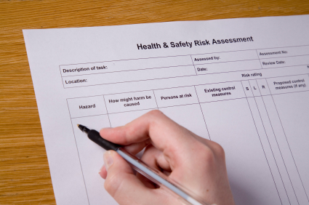
Complete forms and reports
Forms and reports may include:
Communications book
Vehicle use form
Incident report
Compliance reports
Loss and damage assessments
(Continued)
Notes:
Trainer provides examples of forms and reports which may need to be completed:
Communications book – used by venues to facilitate communication between staff who work different shifts/days
Vehicle use form – detailing name of person who used the vehicle, reason for use and odometer readings
Incident report – to record details relating to an incident which has occurred in the venue
Compliance reports – detailing action taken to comply with requests/demands from management and/or authorities
Loss and damage assessments – to record details of events which have caused loss or damage to the venue, stock, facilities or guest items.
Class Activity – Presentation and Explanation/Demonstration
Trainer presents sample forms/reports as listed on the slide and:
Explains what they are used for
Demonstrates what is involved in competing each.

Slide 144

Complete forms and reports
Maintenance request forms
Maintenance reports
Time sheets
Task assignments
Job cards/sheets
(Continued)
Notes:
Trainer continues to provide examples of forms and reports which may need to be completed:
Maintenance Request forms – also known in some venues as Maintenance Requisitions
Maintenance reports – detailing repairs, service and maintenance on items specifying what was done, when it was done and who did it. This form is required when maintenance is undertaken by internal staff or an external provider.
Time sheets – detailing hours worked for a shift: a time clock may replace the need to complete a paper-based time sheet
Task assignments – at the end of the allocated assignment
Job cards/sheets – when allocated work (inspections, repairs, replacements) have been finalised this record will detail:
Who did the job
Time taken
Materials used
Parts and components replaced
These details enable costing of work done.
Class Activity – Presentation and Explanation/Demonstration
Trainer presents sample forms/reports as listed on the slide and:
Explains what they are used for
Demonstrates what is involved in competing each.

Slide 145
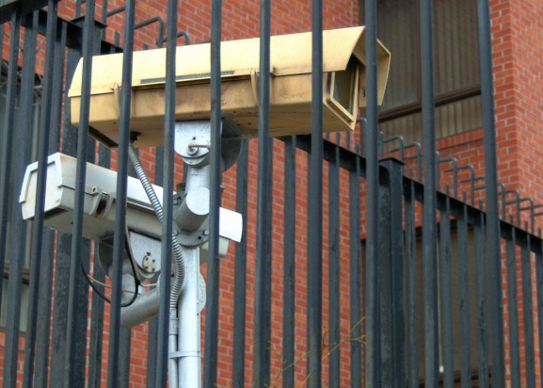
Complete forms and reports
Patrol logs
Suspicious person report
Insurance claims
CCTV surveillance records
Alarm reports/activity logs
(Continued)
Notes:
Trainer continues to provide examples of forms and reports which may need to be completed:
Patrol logs – at the end of vehicle and foot patrols completed at the end of the patrol or end-of-shift to record times and routes as well as operational details
Suspicious person report – completed at the end of the patrol, end-of-shift or after having responded to a call from venue staff to investigate
Insurance claims – lodging a claim on behalf of the venue against an insurance policy held by the property
CCTV surveillance records – to identify discs/tapes stored/maintained for different dates, times and locations/cameras
Alarm reports/activity logs – identifying activated alarms, locations, times and causes including false alarms.
Class Activity – Presentation and Explanation/Demonstration
Trainer presents sample forms/reports as listed on the slide and:
Explains what they are used for
Demonstrates what is involved in competing each.

Slide 146
Complete forms and reports
Response reports
Equipment faults log
Testing and inspection records
Witness statements
Notes:
Trainer continues to provide examples of forms and reports which may need to be completed:
Response reports – detailing action taken in response to alarms and calls for assistance
Equipment faults log – this is used to report operational faults in systems and equipment and to record action taken to record diagnoses
Testing and inspection records – which:
Provide evidence of inspections/tests having been undertaken
Highlight areas where problems/issues have been identified for further action/follow-up
Witness statements – taken when members of the public are prepare to make statements regarding what they observed when an event, incident or offence took place.
Members of the public, customers or guest are under no obligation to make witness statements.
Class Activity – Presentation and Explanation/Demonstration
Trainer presents sample forms/reports as listed on the slide and:
Explains what they are used for
Demonstrates what is involved in competing each.

Slide 147

Complete forms and reports
Lost and Found register
Recommendations – for action/to improve security
Requests for training
Notes:
Trainer continues to provide examples of forms and reports which may need to be completed:
Lost and Found register – detailing items which have been found in the venue and items which have been reported as lost as well as items returned to their owners
Recommendations for action – this is a form allowing staff to formally convey suggestions and ideas for issues such as:
Changes to SOPs
Introduction of new SOPs
Replacement of items
Disposal of faulty or damaged equipment
Purchase of new/different items and equipment.
Request for training – identifying the training required (such as ‘initial training’, ‘top-up training’ or ‘refresher training’) and the items (equipment and/or systems) involved. This training request may also identify ancillary areas in which training is required – these areas may include:
First aid
Maintenance and service.
Class Activity – Presentation and Explanation/Demonstration
Trainer presents sample forms/reports as listed on the slide and:
Explains what they are used for
Demonstrates what is involved in competing each.

Slide 148

Cooperate with management to enhance safety
To demonstrate support for management to improve safety:
Engage with risk management activities
Participate in all staff briefings and meetings
Participate in workplace inspections
Attend relevant conferences and events
(Continued)
Notes:
Trainer identifies an ongoing aspect of everyday work is to cooperate with management to optimise safety of patron and staff safety at the venue highlighting they should participate in a range of activities to demonstrate their support for management in their endeavours:
Engage actively with all aspects of risk management when the need to do so arises – risk identification, risk analysis and risk control
Participate in regular staff briefings, de-briefings and meetings
Participate in scheduled workplace inspections – to:
Confirm existing safety arrangements
Identify new threats/problems
Attend conventions, seminars and conferences which have a safety focus – and report back to management on what you discovered/became aware of.
Class Activity – Guest Speaker
Trainer arranges for relevant venue manager/owner to attend and speak to students about what they as managers/owners expect staff to do to support their attempts to improve venue safety for patrons and staff.

Slide 149
Cooperate with management to enhance safety
Contribute ideas and suggestions
Be willing to trial initiatives & provide feedback
Complete all the internal forms/reports required
Visit other sites/venues
(Continued)
Notes:
Trainer continues identifying ways students can demonstrate support for management to improve venue safety:
Contribute ideas, suggestions and recommendations for improvement to safety – see later slides
Be willing to trial safety initiatives – and provide feedback on their implementation and effectiveness
Compete all internal forms and reports as required – management use these to determine the need for changes to existing safety arrangements
Visit other venues – to determine their safety protocols.

Slide 150
Cooperate with management to enhance safety
Develop and use an industry ‘network of contacts’
Analyse and evaluate documentation
Comply with management directives
Notes:
Trainer continues identifying ways students can demonstrate support for management to improve venue safety:
Develop an industry network of personnel who are involved with venue safety – and communicate regularly with them to share information
Take the time and make the effort to analyse and evaluate indicators of safety performance (such as system reports, written reports, comments from staff and guests) – and provide details of your finding to management
Fully complying with management directives – regarding need for compliance with:
Existing safety policies and procedures
Revisions to safety policies and procedures
Introduction of new safety policies and procedures.

Slide 151
Cooperate with management to enhance safety
Follow a two-stage approach for making recommendation:
Make verbal suggestion
Supplement with written recommendation:
If management seems interested
If requested
Notes:
Trainer advises a two-stage approach for making recommendations recommendations for action to improve venue safety:
Make verbal suggestions first
Supplement these with written recommendations:
If the verbal notification is of interest
If requested.

Slide 152
Cooperate with management to enhance safety
Include the following in written recommendations:
Your name and contact details
Date
Rationale
Action plan
(Continued)
Notes:
Trainer indicates points to include when preparing a written recommendation to improve venue safety:
Your name and contact details – cell phone, extension number
Date – the recommendation was written/submitted
Rationale for the recommendation – explaining why the recommendation is being made
Action plan for implementation – setting out sequential and step-by-step activities necessary to trial/pilot and implement the recommendation.

Slide 153
Cooperate with management to enhance safety
Recommendations for:
Equipment, systems and technology
Providers/suppliers
Timelines
Training required
(Continued)
Notes:
Trainer continues identifying contents of written recommendations to improve venue safety:
Recommendation regarding:
Equipment, systems and technology to be used – including any supporting product information (brochures, quotations, fact sheets)
Provider, supplier and/or installer who should be employed
Timelines for implementation
Training required to support the initiative.

Slide 154
Cooperate with management to enhance safety
Staff/hours required
Transitional arrangements
Benefits anticipated
Costs
Notes:
Trainer continues identifying contents of written recommendations to improve venue safety:
Details of any new staff required – or additional staff hours required
Transitional arrangements (where applicable) – detailing how the initiative/recommendation will be phased in to/integrated with other SOPs of the workplace
Explanation of the benefits which should flow – from implementation of the initiative/proposal
Cost involved – including, as appropriate:
A cost-benefit analysis
Money which may be received as a result of sale of ‘old’ equipment.

Slide 155
Summary – Element 5
When fulfilling administrative responsibilities:
Complete all required internal forms and reports
Complete documents in a timely manner
Focus on accuracy, honesty and comprehensiveness when completing forms
File and forward forms and reports
Cooperate with management to optimise venue safety for patrons and staff
Attend all safety-related staff meetings
(Continued)
Notes:
Trainer provides a recap of the Element asking questions to check trainee understanding and responding to questions from trainees, as required.

Slide 156
Summary – Element 5
Participate actively in venue-specific safety inspections, checks and initiatives
Offer verbal recommendations
Be prepared to supplement verbal recommendations with written recommendations
Notes:
Trainer provides a recap of the Element asking questions to check trainee understanding and responding to questions from trainees, as required.

Slide 157
Respond to a deceased person
Performance Criteria for this Element are :
Contain the situation relating to the body
Contact emergency services
Contact management
Preserve the scene where the body was found
Comfort those affected by the death
Notes:
Trainer identifies for trainees the Performance Criteria for this Element, as listed on the slide.
Class Activity – Discussion
Trainer asks trainees questions about responding to a deceased person by asking questions such as:
Have you ever been involved in a deceased person situation in a venue? What happened? What did staff do?
Why do you think it is necessary to respond appropriately to deceased person situations?
What might be involved in responding appropriately?

Slide 158
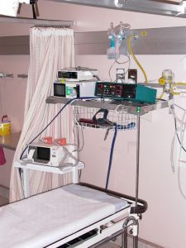
Contain the situation
‘Deceased persons’ situations:
Are distressing for everyone involved
Rarely occur
Only apply where the body is found on the premises
Can involve a guest, patron or member of the public
Can be handled following internal plans for dealing with same
(Continued)
Notes:
Trainer introduces dealing with a deceased person highlighting such a situation is distressing for everyone involved but must be handled professionally and explaining the following helps provide a context for deceased person situations:
The incidence of deceased persons in the industry is very, very low
A ‘deceased person situation’ means a situation where a person is found to be dead on the premises
The deceased person may be a guest who is staying in a room at the venue or a member of the public who was drinking or dining at the venue, or who had wandered into the premises
Many venues have developed their own protocols for handling deceased person situation and where these exist it is important they are adhered to.

Slide 159
Contain the situation
Death may be the result of:
Natural causes
An accident
Criminal action
Notes:
Trainer continues providing context for a deceased person situation:
Death may have been occasioned by:
‘Natural causes’ – such as:
People passing away in their sleep
Old age
Results of a medical condition
An accident – such as:
Choking
A fall
Criminal action – such as:
An assault
Homicide
Suicide.
Class Activity – Guest Speaker
Trainer arranges for manager of local venue to attend and talk to students about:
Protocols at their venue for dealing with deceased persons
Training in this regard for staff
Stories of their experience with deceased persons.

Slide 160
Contain the situation
If you find a deceased person:
Notify Front Office immediately – use code
Do not touch anything
Provide whatever assistance/comfort you can to those at the scene
Let management talk to media or guests
Demonstrate dignity for the deceased
Notes:
Trainer identifies acceptable course of action if deceased person is found:
Immediately notify Front Office, Security or the designated department or person in the venue – this must be the non-negotiable first step before you do anything else.
You must notify someone internally you have discovered what you believe to be a dead body.
This is done so assistance will start moving your way immediately.
The venue may have a special code for this situation – for example:
“This is David in Room 236. We have a code 83 here”
“This is David at the swimming pool. Code 83. Single male.”
Do not touch anything at the scene – you must ‘preserve the scene’: see later slides
Do what you can to provide assistance and comfort to those who may be impacted – see later slides
Never talk to guests, members of the public or the media about the deceased person or the situation – leave this to management, the authorities or the designated venue PR person
Take whatever action is necessary given the circumstances to maintain dignity for the deceased – this can include:
Talking in a quiet voice
Using respectful language.
Class Activity – Role Play
Trainer conducts role play where student discovers deceased person and is required to notify Front Office of same.

Slide 161
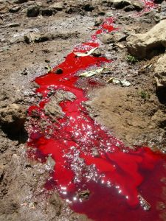
Contain the situation
‘Containing the scene’ = restricting impact on others.
Actions include:
Preventing others seeing the body
Not talking about the situation
Limiting fallout on normal venue operations
Notes:
Trainer explains ‘Containing the situation’ means taking action to restrict the impact of the deceased person on others presenting actions to help achieve this:
Doing whatever is required to prevent others seeing the body – this may require you to:
Close doors
Lock doors
Draw curtains or blinds
Block pedestrian and/or vehicular traffic – but ensure you create alternative traffic routes to help maintain movement past the situation
Arrange for Security guards to be posted to restrict access
Erect a physical barricade around the body
Refraining from talking about the situation so guests and members of the public can hear what is being said – this includes:
One-to-one conversations with venue staff
Telephone discussions
Conversations at the time the body is discovered as well as at later times
Limiting the fallout from the event – this means dong what you can to maintain normal venue operation to the best extent possible:
Making sure your responses are reasonable and not over-reactive – be certain to use common sense at all times
Avoiding shouting.

Slide 162
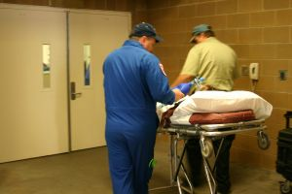
Contact emergency services
Where a deceased person is discovered:
Emergency services MUST be contacted
‘Dual response’ should be asked for:
Police
Ambulance
Notes:
Trainer states it is important to contact emergency services as part of the response to a deceased person situation highlighting:
The standard response to what is assumed to be a deceased person situation is to activate a ‘dual response’. This means the venue must contact:
Police:
So they can investigate the situation
Ambulance:
So they can:
Verify the person has indeed passed away
Render necessary first aid in the event the person has not died.

Slide 163
Contact emergency services
Contacting emergency services:
Allow Front Office to do this when you have notified them
If you have to make the call:
Do it quickly – so guests cannot overhear
Log the call – for future reference if needed
Notes:
Trainer states contacting the emergency services should occur in accordance with the following:
Allow Front Office, Security or the nominated person you have already contacted to contact the emergency services
If you have to make the call:
Make it as soon as possible
Use landline or cell phone
Make sure no guest or member of the public can hear you make the call
Log the call – so the venue can demonstrate:
It made the call
The time the call was made
Name of the person who made the call.

Slide 164
Contact emergency services
When phoning emergency services:
Advise you want to report a dead body
Respond to operator’s questions
Ask for dual response
Provide other details you deem relevant
Notes:
Trainer advises procedure is to ring the emergency number and:
Advise them you are reporting a dead body situation – and allow them to take the lead in terms of asking questions they want you to answer.
The operator will ask questions such as:
Name of venue
Address
Nearest cross street/intersection
Your name
Number of bodies
Number of injured people
Possible cause of death
Is there a weapon present/visible?
Are other people in danger/at threat?
Location of the body within the venue – room number, name of the room the body is in or external location
Directions on how to get to the body
You may contribute the following to the exchange with the operator:
Request for dual response
Suggestion for location for attendance of emergency vehicle/s
Advice someone from the venue will be there to direct officers to ‘the scene’.
Class Activity – Demonstration and Practical Exercise
Trainer demonstrates to students how to call the emergency services and report a deceased person and provides opportunity for students to practice same.

Slide 165
Contact management
Contacting management:
They must be contacted when a deceased person is discovered
Follow house protocols regarding sequence/timing of this
If no guidelines exist – contact emergency services first
Where Front Office has been notified, they will contact management
Notes:
Trainer highlights:
It is also standard procedure to be contacted whenever there is a deceased person on the premises
Follow house protocols in this regard:
Some may require management to be contacted before emergency services are contacted
Some may require emergency services to be contacted first.
If no internal rule is in place, call emergency services before contacting management
Where you have already notified Front Office about the deceased person, they will contact management.

Slide 166
Contact management
If you have to notify management about a body:
Do it promptly – use a phone: identify yourself
Provide information about the body
Give information about the scene
Advise of any action taken
Suggest action to take
Seek directions and ask questions
Notes:
Trainer explains requirements if students need to contact management about a deceased person:
Promptly – with reference to ‘Timing’ issues already identified.
The owner or Duty Manager must be notified as soon as possible.
Using the telephone – making sure the conversation cannot be heard by customers/guests or members of the public
Telling them your name and where you are speaking from
Providing information:
About the body – covering aspects such as:
Where it is
Who it is
Your first thoughts about cause of death with a focus on whether you believe the death was as a result of natural causes or whether ‘foul play’ is obvious or suspected
About the scene – in relation to:
Whether or not others are aware of the body
If the body is visible to the public
Has a crowd gathered at the scene
What action you have taken – to this point, for example:
Whether you have notified emergency services or not
Whether you have notified Front Office or not
Suggestions for action – in order to:
Minimising alarm and concern among guests
Preventing access to the scene by members of the public
Secure/preserve the scene
Asking questions – about:
What they want you to do
What they do not want you to do
Who you should contact.

Slide 167
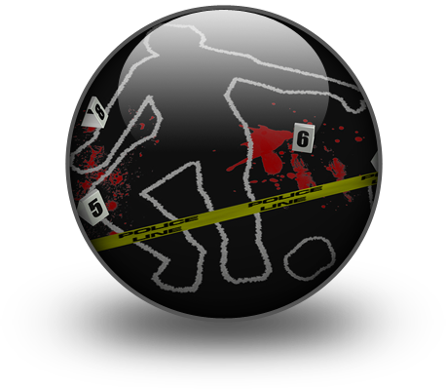
Preserve the scene
Part of your response to a deceased person is to ‘preserve the scene’ – this must be done to:
Avoid contamination of the scene
Avoid contamination of evidence
Allow investigators to do their work
Notes:
Trainer explains whether the deceased person is found inside the venue or in an outside area of the property it is important for staff to ‘preserve the scene’ for the following reasons:
Avoid contamination of the scene – by allowing material to be ‘walked into’ the scene or otherwise introduced into the scene
Avoid contamination of evidence which may be present at the scene – such as weapons
Allow investigators to view (and photograph) the scene exactly as it was when the ‘event’ (the death of the person) occurred
Enable the officials to take notes about the scene for their later investigation.

Slide 168

Preserve the scene
To preserve the scene:
Do not touch the body
Do not move anything in the room
Do not move/touch anything ‘in the vicinity’
(Continued)
Notes:
Trainer presents actions to help preserve the scene where a deceased person in discovered:
Not touching the body
Not moving anything in the room where the body was found – such as re-locating items
Not touching or moving anything in the immediate vicinity of where the body was discovered.

Slide 169

Preserve the scene
Not allowing others into the room
‘Not allowing others to walk through the scene
Not allowing anyone to remove anything from the scene
Making sure no-one else touches or moves anything
Notes:
Trainer continues presenting advice on preserving the scene:
Not allowing others into the area/room
Preventing others walking through the area
Not permitting anyone taking/removing anything from the scene
Making sure no-one else moves items at the scene.
Class Activity – Guest Speaker
Trainer arranges for Police Officer to visit and talk to students about:
Action to take when discovering a deceased person in a bed in a guest room
Action to take when discovering a deceased person elsewhere in the building – such as a public space or in an outside location
Contacting emergency services
Advice for preserving the scene.

Slide 170
Preserve the scene
You might also:
Recall your own actions
Note who else was present/on-the-scene
Ask/encourage people to stay until police arrive
Notes:
Trainer provides supplementary suggestions for action:
Recall your own actions which have already been taken which may have inadvertently contaminated/altered the scene – for example, you might note:
How you entered the room/area
Things you actually did touch/move – before you knew you were involved in a deceased person situation
Take note of the other people who were present when the body was discovered – so their names/description can be passed on to police
Ask any witnesses to remain so they can assist the authorities with their enquiries – note you do not have the power to:
Insist or detain people remain until the police arrive
Demand people give a witness statement.

Slide 171
Comfort those affected
All the following may need attention/comfort as a result of a death on the premises:
Family and friends of the deceased
Other guests
Staff
Notes:
Trainer identifies after a death on the premises the following people may have been impacted and may need attention/comfort:
Family and friends of the deceased
Other guests and customers in the venue
Staff.

Slide 172
Preserve the scene
Guidelines for providing comfort:
Follow internal protocols
Always use common sense
Comfort guest before staff
Comfort children before adults
Hold de-briefing sessions for staff
(Continued)
Notes:
Trainer states the guidelines for providing comfort are:
Follow internal procedures which apply – which will identify:
Staff to be involved
Locations where people should be taken (away from the scene)
Actions which can be taken to provide comfort
Always use common sense – about:
What to do
What to use
Priorities
Comfort guests and customers before comforting staff
Comfort children before adults – unless their parents are present, in which case allow the parents to comfort their children
Provide formal de-briefing sessions with staff – to help them come to terms with what has happened and assist in the general recovery process.

Slide 173

Preserve the scene
Use these techniques
Remove them from the scene
Give words of comfort and consolation
Reassure them
Offer a hot drink and tissues
Be a ‘shoulder to cry on’
Provide a simple physical presence
(Continued)
Notes:
Trainer continues providing guidelines for providing comfort:
Use the following to provide comfort – this is required to those who may be related to the deceased person or people who are distressed at having seen the body and/or the circumstances surrounding the body:
Remove them from the scene – take them to another area/room
Words of comfort/consolation
Reassurance
A hot beverage – never offer alcohol
Tissues
A ‘shoulder to cry on’
A physical presence – someone to talk to. It is critical to understand many people impacted in this way simply want someone to talk to. They do not really need you to say anything/much but they need to know you are listening, and you are ‘there’ sharing their experience.

Slide 174
Preserve the scene
Offer to contact family or friends for them
Avoid telling them what to do/giving foolish advice
Ask them what they need
Obtain profession counselling assistance
Be alert for the potential for those affected to go into shock
Notes:
Trainer continues providing guidelines for providing comfort in relation to techniques which may be used:
Offer to contact family or friends
Avoid:
Telling them to ‘be strong’
Telling them you know what they are going through
Ask them to tell you what they want/need to cope with the situation – “What can I do for you?”
Obtain external professional help (counselling) to cope with the situation
Be alert to the potential for people to be affected by shock – and provide first aid for same.
Class Activity – Demonstration and Practical Exercise
Trainer demonstrates how to provide comfort and assistance to a guest who has been affected by a death on the premises and then provides an opportunity for students to practice the same.

Slide 175
Summary – Element 6
When responding to a deceased person:
Follow house protocols where they exist
Treat the deceased person with respect
Contain the situation to the best of your ability at the time
Notify management or the designated person immediately
Contact emergency services and ask for ‘dual response’
Prevent access to the scene by others
(Continued)
Notes:
Trainer provides a recap of the Element asking questions to check trainee understanding and responding to questions from trainees, as required.

Slide 176
Summary – Element 6
Do not touch anything
Do not touch the body
Do not contaminate the scene
Comfort guests and staff impacted by the death
Notes:
Trainer provides a recap of the Element asking questions to check trainee understanding and responding to questions from trainees, as required.
Trainer thanks trainees for their attention and encourages them to apply course content as required in their workplace activities.

